Slide 1
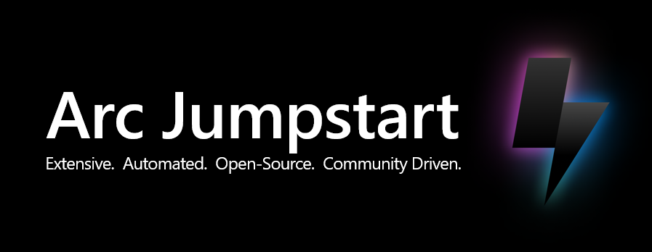
aka.ms/ArcJumpstart

Slide 2






























Azure Arc solution overview architecture
Unified operations, management, compliance, security, and governance
Arc-enabled servers, Arc VMs, SQL Server, and Kubernetes resources
Arc-enabled services resources
(data, app, and ML services)
Arc-enabled industrial assets resources
Azure Resource Manager (ARM)
Azure control plane span across cloud and edge via Azure Arc
Multi cloud
On-premises
Operational edge
Servers, SQL, and Kubernetes
Arc-enabled services
Servers, SQL, and Kubernetes
Arc-enabled services
Servers and Kubernetes
Industrial assets
Azure IoT Operations enabled by Arc
Azure Local
System Center Virtual Machine Manager

Slide 3



















Arc extensibility model
Microsoft Defender for Cloud
Azure Policy
Azure Monitor
Azure Key Vault
Flux (GitOps)
Azure IoT Operation enabled by Azure Arc
Azure AI Video Indexer enabled by Azure Arc
Azure Container Storage enabled by Azure Arc
Arc-enabled data services
Arc-enabled Machine Learning
Arc-enabled Container Apps
Azure Logic Apps
Dapr extension
Arc-enabled Kubernetes
Cluster Extensions
SQL Server enabled by Azure Arc
Extended Security Updates (ESU)
Dashboards
Best practices assessment
Microsoft Defender for Cloud
Migration assessment
Microsoft Defender for Cloud
Microsoft Sentinel
Custom Script extension
Azure Policy
Log Analytics
Azure Monitor
Azure Key Vault
Azure Automation
OpenSSH for Windows
Entra ID based SSH for Linux
Datadog Agent
Arc-enabled servers
Extensions
Arc-enabled VMware vSphere
Arc-enabled SCVMM
Azure Local 1st party Arc integration

Slide 4





Arc-enabled servers and SQL Server – Compliance options view
Unified operations, management, compliance, security, and governance
Azure management interface
Azure portal
Azure CLI / PowerShell
Azure SDK
REST API
Azure management interface
Azure Arc integrations
ITOps
Threat Protection
Observability
Secrets
Change Tracking
Extensibility
Patching
Automanage
Tags
Native Azure
Azure Arc projected resources
Healthcare Azure Policy
Federal Risk and Authorization Management Program (FedRAMP) Azure Policy
Canada Federal PBMM Azure Policy
Windows and Linux virtual machines
Arc-enabled servers and SQL Servers
Arc-enabled servers and SQL Servers
Arc-enabled servers and SQL Servers
Azure Local
Azure
On-premises
Multi cloud

Slide 5
Arc-enabled servers – Connected Machine agent architecture
Azure management interface
Azure Arc Connected Machine Agent
Configuration passed to the Agent:
Subscription and resource group
Azure Region to store metadata
Network options (direct, proxy, or private link)
Credential to onboard (device login, AAD token, or SPN)
ITOps
HTTPS 443
Azure portal
Azure CLI / PowerShell
Azure SDK
REST API
Microsoft Entra ID
Azure Resource Manager (ARM)
Hybrid Instance Metadata Service (HIMDS)
Handles managed identity and metadata sync (heartbeats)
Authentication & Authorization
Hybrid Compute
resource provider
Guest Configuration
Provides In-Guest Policy and Guest Configuration functionality, such as assessing whether the machine complies with required policies
Hybrid Connectivity resource provider
Extension Manager
Manages VM extensions, including install, uninstall, and upgrade
Guest Configuration
resource provider
Azure Monitor multiple resource provider
Custom Script
Microsoft Defender for Endpoint (MDE)
Azure Monitor Agent (AMA)

Slide 6
Arc-enabled servers – Identity and access management
1a
Create service principal and a short-lived client secret with Azure admin
Microsoft Entra ID
Service Principal
Managed Identity
Entra ID user
ITOps
Azure administrator
1b
Grant “Azure Connected Machine Onboarding” role to service principal for least privileged access
3b
Managed Identity is created in Azure AD enterprise applications
1c
Grant “Azure Connected Machine Resource Administrator” role to server admin for least privileged access
Azure Resource Manager (ARM)
Hybrid Compute
resource provider
Guest Configuration
resource provider
Log Analytics Workspace
2a
Login to Azure portal and generate server onboarding script
Extensions are managed using Azure token obtained with managed identity credentials
Guest configuration updates are managed using Azure token obtained with managed identity credentials
6
5
Monitoring agent configuration and workspace tokens obtained with managed identity credentials
Arc-enabled server
3a
Azure Arc-enabled server resource is created using service principal credentials
Connected Machine Agent
ITOps
Server administrator
Host Instance Metadata Service (HIMDS) managed identity credentials
Guest Configuration Extension service
Guest Configuration
Arc service
Azure Monitor Agent (AMA)
7
2b
Using RDP/SSH or automation tooling login to server with local admin rights
3d
3e
Azure Update Manager
2c
Run server onboarding script by providing service principal and client secret
HIMDS service is created and runs under NT Service\himds virtual account with least privileges
Guest configuration extension service is created and runs under Local System account
Guest configuration Arc service is created and runs under Local System account
3g
Run Command
4
3c
Managed Identity credentials are stored in local storage using ACL
Extensions are created using Local System account privileges of extension service
Hybrid agent extension applications local security group is created to authorize members to request Azure tokens through HIMDS service
3f

Slide 7









Arc-enabled servers – Private Link integration
Azure Arc
Private Link Scope
Azure Arc
Private Link Endpoint
Internet
Hybrid Compute resource provider
Guest Configuration resource provider
Azure Resource Manager (ARM)
Microsoft Entra ID
Setup Scripts and Installation Packages
Azure Virtual Network
Hybrid Connectivity resource provider
Azure Automation
Azure Automation
Private Link Endpoint
Azure Log Analytics Workspace
Azure Monitor
Private Link Endpoint
Azure Relay resource provider
Azure ExpressRoute / VPN
Azure Monitor
Private Link Scope
HTTPS 443
Authentication and Authorization
On-premises / Cloud network
Proxy / Firewall
Arc-enabled servers
Azure Local

Slide 8


Arc-enabled servers – Azure Key Vault Integration
Public Key Infrastructure (PKI)
ITOps
Microsoft Entra ID
6
1b
AKV is configured with Azure Managed Identity for allowing the Arc-enabled server to access certificates
Upon renewal time, the certificates are renewed only in AKV (renewed PKI certs can be uploaded as well)
AKV Extension background service request for a Managed Identity token in order to retrieve certificates
3a
3b
1a
Azure Key Vault (AKV)
AKV Extension background service
retrieve AKV certificates based on interval specified in the extension configuration. The AKV agent will then sync down the new certificate and private key automatically at its next sync interval
Arc-enabled server
IT Ops administrator deploy Azure Key Vault
User certificates
AKV Extension Background Service
App/Service
(i.e. Web Server)
Certificates URIs are used as parameters and syncs based on user-defined time intervals
5
App/Service consumes local cert store certificate
(as well rebind upon renewal)
2a
Hybrid Compute resource provider
AKV extension is deployed on the Arc-enabled server
2b
4
Cert Store
Extension service
The certificates and private keys are stored in the local certificate store (Windows) or as files in a directory (Linux)

Slide 9





Azure Arc gateway – Arc-enabled servers solution architecture (Public Preview)
Target services endpoints reached via Arc gateway using HTTP tunnels over HTTP2
Arc gateway is reached using TLS connection
On-premises infrastructure
Arc gateway ARM resource
[unique-guid].gw.arc.azure.com
Arc gateway proxies traffic only to Azure services endpoints
On-premises server
Azure Arc Connected Machine Agent
Arc proxy forwards traffic via on-premises enterprise proxy
Azure endpoint targets
Arc-enabled servers core services
Arc proxy
Enterprise proxy
Hybrid Identity Service traffic routes directly
Hybrid Identity Service
gbl.his.arc.azure.com
Additional Azure services endpoints via Arc extensions
Arc agentry & extensions use the Azure Arc Proxy as their forward proxy
Azure Monitor
Arc extensions
Microsoft Entra ID traffic routes directly
Microsoft Entra ID
login.microsoftonline.com
Microsoft Defender for Cloud
ARM traffic routes directly
Azure Resource Manager (ARM)
management.azure.com
Azure Update Manager

Slide 10

Azure Arc gateway – Arc-enabled Kubernetes solution architecture (Public Preview)
Target services endpoints reached via Arc gateway using HTTP tunnels over HTTP2
Arc gateway is reached using TLS connection
On-premises infrastructure
Arc gateway ARM resource
[unique-guid].gw.arc.azure.com
Arc gateway proxies traffic only to Azure services endpoints
On-premises Arc-enabled Kubernetes cluster
Arc-enabled Kubernetes Cluster Agentry
Arc proxy forwards traffic via on-premises enterprise proxy
Azure endpoint targets
Arc-enabled Kubernetes core services
Arc proxy
Enterprise proxy
Hybrid Identity Service traffic routes directly
Hybrid Identity Service
gbl.his.arc.azure.com
Additional Azure services endpoints via Arc extensions
Arc agentry & extensions use the Azure Arc Proxy as their forward proxy
Azure Monitor
Microsoft Entra ID traffic routes directly
Arc extensions
Microsoft Entra ID
login.microsoftonline.com
Microsoft Defender for Cloud
ARM traffic routes directly
Azure Resource Manager (ARM)
management.azure.com
GitOps
Microsoft Container Registry traffic routes directly
Microsoft Container Registry
mcr.microsoft.com

Slide 11
Azure Arc gateway – Forwarding protocol architecture (Public Preview)
Arc extension
Azure Arc Proxy
Enterprise Proxy
Arc gateway
Azure service
1
Arc extensions open a TCP connection to the Arc proxy
3
Arc Proxy establishes a TCP session with the enterprise proxy
2
HTTP::Connect (target)
Arc Extensions make a connect request to forward the connection to the target service of interest
4
HTTP::Connect (gateway)
5
Arc Proxy makes a connect request to forward the connection to the Arc gateway
Enterprise Proxy establishes a TCP session with Arc gateway
6
HTTP 200
Since the TCP session has been established with Arc gateway, enterprise proxy responds with a HTTP 200 Success. Now, Azure Arc Proxy has a logical TCP connection all the way to Arc gateway
7
Since Arc gateway is serving on HTTPS (Using HTTP2), a TLS Session gets established between Arc Proxy and Arc gateway
9
If the Arc gateway access policies allow connection to the target service, Arc gateway establishes a TCP connection to the target service
8
HTTP::Connect(Target)
Arc proxy runs a nested HTTP connect within the TLS session. Note: Enterprise proxy is unaware of this, as this happens inside of the TLS session between the proxy and the Gateway
Since the TCP connection has been established with the Target Service, Arc Proxy responds with a HTTP 200 Success
10
HTTP 200
11
HTTP 200
Since the TCP session has been established with the Target Service, Arc gateway responds with a HTTP 200 Success. Now, Azure Arc Proxy has a logical TCP connection all the way to the target service.
12
A TCP Level connection is now established between the extension, and the target service. Typically, extensions establish an additional end-to-end TLS session with the Target Service

Slide 12


Azure Arc gateway – Azure Local solution architecture (Public Preview)
Azure services endpoints
Internet
Identity
Extensions
Connection
…
Arc gateway
allowed endpoints
Arc gateway ARM resource
Enterprise outbound proxy or firewall
Arc gateway denied endpoints go over enterprise proxy/firewall automatically (endpoints must be permitted on the enterprise proxy or firewall)
On-premises network
Azure Local instance
Azure Local machine 1 HTTPS tunnel
Azure Local machine 2 HTTPS tunnel
Azure Arc Connected Machine Agent
Azure Arc Connected Machine Agent
Azure Local machine 1
Azure Local machine 2
Arc proxy
Routable IP address
Arc proxy
3rd party outbound HTTP and HTTPS network traffic
3rd party outbound HTTP and HTTPS network traffic
AKS and ARB outbound HTTP and HTTPS network traffic
Machine OS outbound HTTP and HTTPS network traffic
Machine OS outbound HTTP and HTTPS network traffic
Machine Operating System
host components
Arc Resource Bridge (ARB) appliance VM
Machine Operating System
host components
3rd party endpoint
(i.e. backup agent, monitor agent, etc.)
Azure Kubernetes Service (AKS) control plane
3rd party endpoint
(i.e. backup agent, monitor agent, etc.)
ARB VM can move between nodes

Slide 13
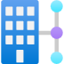

Azure Firewall Explicit proxy – Arc-enabled servers connectivity (Public Preview)
Required Azure Services and Extensions
On-premises infrastructure
Azure Virtual Network
Arc-enabled servers services
On-premises server
Azure Firewall
Explicit proxy enabled
Azure Arc Connected Machine Agent
Azure ExpressRoute or Site-to-Site VPN
Allowed
endpoints
The Azure Firewall Explicit proxy is set as the forward proxy for each Arc Agent
Azure Monitor
Extension Manager manages VM extensions, including install, uninstall, and upgrade
Arc extensions
Azure Firewall Application Rules can be used to control which endpoints are allowed to be reached
Microsoft Defender for Cloud
Azure Update Manager

Slide 14
Azure Firewall Explicit proxy – Arc-enabled Kubernetes connectivity (Public Preview)
Required Azure Services and Extensions
On-premises infrastructure
Azure Virtual Network
Arc-enabled Kubernetes services
On-premises
Arc-enabled Kubernetes cluster
Azure Firewall
Explicit proxy enabled
Arc-enabled Kubernetes Cluster Agentry
Azure ExpressRoute or Site-to-Site VPN
Allowed
endpoints
The Azure Firewall Explicit proxy is set as the forward proxy for each Arc Agent
Extension Manager manages cluster extensions, including install, uninstall, and upgrade
Azure Monitor
Arc extensions
Azure Firewall Application Rules can be used to control which endpoints are allowed to be reached
Microsoft Defender for Cloud
Azure GitOps

Slide 15



Arc-enabled Kubernetes – Cluster onboarding workflow architecture
Cluster admin
3f
Create Service Principal in Microsoft Entra ID
1
Microsoft
Entra ID
Managed Identity service
Fetch the identity certificate
5b
Onboard cluster
3d
Create Managed Identity
3e
PUT resource Microsoft.Kubernetes/connectedClusters with public key (management.azure.com)
4
Azure CLI and Azure PowerShell
Azure Resource Manager (ARM)
Save identity metadata
Hybrid Identity service
Fetch Helm chart
Microsoft.Kubernetes
resource provider
2
Microsoft Container Registry
Update cluster metadata
Arc-enabled Kubernetes Data Plane service
PUT connectedCluster resource
along with Managed Identity metadata
3g
6d
6c
Pull agent images
3c
Push cluster metadata (uses Managed Identity to authenticate eastus.dp.kubernetesconfiguration.com)
Arc-enabled Kubernetes cluster
3a
6a
Fetch cluster metadata and update custom resource
Cluster Metadata operator
Uses Helm to deploy Arc-enabled Kubernetes agents with onboarding private key
6b
Watch for updates in cluster
metadata custom resource
Kubernetes API server
Resource Sync operator
etcd
Save state and onboarding private key in Kubernetes datastore
Cluster Identity Operator
5a
3b
5c
Save the Azure identity certificate
Fetch connectedCluster Managed Identity certificate
(uses onboarding private key to authenticate eus.his.azure.com)

Slide 16

Arc-enabled Kubernetes – Connected cluster management architecture
Cluster admin
1
Prepare prerequisites for onboarding Arc-enabled Kubernetes
Microsoft Container Registry
Azure Monitor
Arc-enabled Kubernetes onboarding Interfaces
Arc-enabled Kubernetes cluster resource
7
Arc-enabled Kubernetes Connect Service
Query Log Analytics workspace for issues and raise alerts
Azure portal
Kubernetes Config Service
Azure Log Analytics Workspace
PowerShell
Azure CLI
5
6
Azure REST API
Install Arc-enabled Kubernetes cluster extensions using the k8s-extension command
Pull Azure Arc-enabled Kubernetes helm charts and agent images and deploy agent pods
Update connected cluster status using heartbeat
Push Arc-enabled Kubernetes cluster logs and metrics to Azure Log Analytics workspace
kubectl
3
4
2
Onboard Kubernetes cluster to Arc the using connectedk8s command
Arc-enabled Kubernetes cluster
API server
Arc-enabled Kubernetes agent tree
Arc-enabled Kubernetes cluster extensions (Azure Policy, Microsoft Defender for Cloud, Flux, Azure Monitor, Azure Key Vault, etc.)

Slide 17






Arc-enabled Kubernetes – Network connectivity architecture
SaaS Git services (i.e GitHub, Azure DevOps)
Microsoft Entra ID
Azure Resource Manager (ARM)
Azure Virtual Network
Microsoft Container Registry (for Arc containers)
Arc-enabled Kubernetes cluster ARM resource
Azure Arc
Private Link Endpoint
Azure Monitor
Private Link Endpoint
Azure Key Vault
Private Endpoint
Azure Arc
Private Link Scope
Azure Monitor
Private Link Scope
Azure ExpressRoute / VPN
Arc containers pulled from MCR via on-premises or 3rd party cloud provider firewall or proxy
Azure Log Analytics Workspace
Azure Key Vault
HTTPS 443
On-premises or 3rd party cloud provider network connectivity via firewall or proxy
On-premises or 3rd party cloud provider network connectivity via ExperssRoute or Site-to-site VPN
Git APIs
HTTPS 443
On-premises or 3rd party cloud provider network
User’s Git infrastructure
Arc-enabled Kubernetes cluster
Git APIs
HTTPS 443
Kubernetes workloads

Slide 18
Arc-enabled Kubernetes – Cluster Connect network architecture
Any network location
HTTPs 443
Microsoft Entra ID
Cluster admin
Microsoft Entra ID authentication and authorization with Conditional Access Policies
HTTPs 443
Azure Resource Manager (ARM)
Arc-enabled Kubernetes cluster resource
Arc-enabled Kubernetes Connect service
HTTPs 443
Kubernetes Config service
Data plane service
az connectedk8s proxy
listClusterUserCredentials
Internet
HTTPs 443
On-premises or 3rd party cloud provider firewall and/or proxy
Microsoft Entra ID Authentication and Authorization
Heartbeat & Cluster Connect relay communication
On-premises or 3rd party cloud provider network
Arc-enabled Kubernetes cluster
Kubernetes API server
kube-aad-proxy
kube-aad-proxy

Slide 19
Arc-enabled Kubernetes – Cluster connect connection workflow architecture
Microsoft Entra Identity (User Account/Service Principal)
Azure Resource Manager (ARM)
Microsoft.Kubernetes
resource provider
1
2
az connectedk8s proxy
listClusterUserCredentials
Data plane service
Client-side proxy
Hybrid connections
heartbeat
User firewall
Arc-enabled Kubernetes cluster
clusterconnect-agent
kube-aad-proxy
API server

Slide 20

Arc-enabled Kubernetes – Cluster extension installation workflow architecture
Cluster admin
6
GET version
1
Azure Resource Manager (ARM)
4
Create extension
Store extension resource
Azure Container Registry or
Microsoft Container Registry
3
Arc-enabled Kubernetes Data Plane service
Azure portal and Azure CLI
Microsoft.KubernetesConfiguration
resource provider
PUT extension resource
5
GET pending extension resources
(uses Managed Identity to authenticate)
12
POST extension status
2
Arc-enabled Kubernetes cluster
PUT resource
Microsoft.Kubernetes/connectedClusters/clusterName/providers/Microsoft.KubernetesConfiguration/extensions/extensionName
(uses ARM extension resource pattern)
Kubernetes namespace
7
9
Create extensionconfig CRs
Fetch Helm chart
stored as OCI artifact
extensionconfigs custom resource extension
Config agent
11
Collect status
Helm release
Watch extensionconfig CRs
8
Kubernetes resources
extension-manager
Install helm chart
10

Slide 21
Arc-enabled Kubernetes – Custom locations architecture (Arc-enabled data services example)
Cluster admin
Azure Resource Manager (ARM)
1
4
Fetch kubeconfig with cluster on which custom location exists
Create Arc data controller
Azure portal and Azure CLI
Microsoft.Kubernetes
resource provider
Microsoft.ExtendLocations
resource provider
2
Microsoft.AzureArcData
resource provider
PUT Microsoft.AzureArcData/dataControllers
PUT request set to RP
3
Arc-enabled Kubernetes cluster
Use kubeconfig to create/update/delete Arc data service custom resource on the custom location mapped to namespace
Custom location mapped Kubernetes namespace
5
Arc-enabled data services custom Resource extension
Watch ideal state declaration in custom resources and realize the same on the cluster
6
Arc-enabled data services operators

Slide 22

Arc-enabled Kubernetes – flux cluster extension architecture
1
Create extension
Azure Resource Manager (ARM)
Azure portal and Azure CLI
4
Cluster admin
Microsoft.KubernetesConfiguration
resource provider
Store fluxConfiguration resource
2
PUT resource
Microsoft.Kubernetes/connectedClusters/clusterName/providers/Microsoft.KubernetesConfiguration/fluxConfigurations/configName or
Microsoft.Kubernetes/managedClusters/clusterName/providers/Microsoft.KubernetesConfiguration/fluxConfigurations/configName
(uses ARM extension resource pattern)
3
PUT fluxConfiguration resource (If microsoft.flux extension, continue)
Arc-enabled Kubernetes Data Plane service
Arc-enabled Kubernetes cluster
Kubernetes namespace
flux cluster extension
GET pending fluxConfiguration resources
(uses MSI to authenticate)
POST status for the Flux CRs
to be retrieved with resource GET
6
Watch FluxConfig CRs
Create FluxConfig CR
13
fluxconfig-agent
Custom Kubernetes resources
14
7
5
FluxConfigs CR
configName
Watch FluxConfig CRs
12
GitRepository CR
8
Create GitRepository CR
and Kustomization CRs
Git repository
Background threads
update status
fluxconfig-controller
Kustomization CRs
YAML files
Helm releases CRs
Watch Flux CRs
9
11
Sync repository
Helm release
Flux Controllers Source, Kustomize, Helm, Notification
Kubernetes resources
10
Deploy Kubernetes resources

Slide 23


Arc-enabled Kubernetes – GitOps configuration workflow architecture
Application v1 (Desired state)
Application v2 (New desired state)
Application update
Flux operator initiates user’s application deployment on the cluster, representing the current desired state
Flux operator initiates application rolling update on the cluster while removing application’s old version Kubernetes pods, resulting in a new application desired state
User is updating the application (creating a new app version) and merge changes to the repository
8
5
6
3
Flux operator begins ”listening” to the Git repository with the user’s application code
4
GitOps configuration
Flux operator deployed on the cluster
Flux controllers
Git repository
Flux captures the update on the Git repository
7
User creates cluster’s GitOps configurations
2
1
Arc-enabled Kubernetes cluster
Arc-enabled cluster is created using any CNCF Kubernetes distribution, deployed on any infrastructure type
Any Kubernetes, any Infrastructure

Slide 24


Arc-enabled Kubernetes – CI/CD and Cluster Configuration GitOps workflow architecture
Continues integration and delivery (CI/CD) tooling
Arc-enabled Kubernetes cluster
Microsoft
Container Registry
Kubernetes API server
Push image
CI pipeline
CD pipeline
Pull image
Deploy state change
Deploy state change
Code updates
CI trigger
CD trigger
Application namespace
Kubernetes cluster resources
Pods, Services, ConfigMaps, etc.
Namespaces, Services, ServiceAccounts, Roles, etc.
Developer
Application code repository
Image tag update
Application config updates
Pull application configuration
flux cluster extension
Application GitOps configuration
Application Operator
Application config GitOps repository
Kubernetes cluster config updates
Pull Kubernetes cluster configuration
Kubernetes cluster GitOps configuration
Cluster Operator
Kubernetes cluster config GitOps repository

Slide 25

Arc-enabled Kubernetes – Microsoft Entra ID role-based access control architecture
Microsoft Entra Identity (User Account/Service Principal)
Owner role
assignment in Azure
6
1
3
4
If allowed, return list of pods
kubectl get pods
checkAccess
allowed/denied
Arc-enabled Kubernetes cluster
2
TokenAccessReview
SubjectAccessReview
API server
Guard
5
allowed/denied

Slide 26

Arc-enabled Kubernetes – Azure Policy (Gatekeeper) architecture
Azure Policy
Arc-enabled Kubernetes cluster
Kubernetes resources
CRDs
Pod
Service
Custom Resource Definition (CRD)
PolicyTemplate CRD
Deployment
Ingress
Deployment
PolicyInstance CRD
watch
create
Fetch policy definitions, assignments, and
Report compliance
1
kubectl apply –f privileged.yaml
AdmissionReview request
2
Gatekeeper
Calling entity
Kubernetes API server
Open Policy Agent (OPA)
deploy
azure-policy-addon
4
Denied
AdmissionReview response allowed: false
3

Slide 27

Arc-enabled Kubernetes – Azure Key Vault Secret Store Extension architecture
Operations administrator
Operations administrator
install and configure the Secret Store Arc cluster extension on the Arc-enabled Kubernetes cluster
Azure Key Vault
1
Secret Store Arc cluster extension
Edge-located Arc-enabled Kubernetes cluster
6
Azure Key Vault Provider
pull secret data
Extension initiate Kubernetes resources deployment
2
Kubernetes control plane node
Secret Store Extension
Secret Store
Secret Store Controller create secret
Secret Store Custom Resource Definition (CRD)
Secrets Store CSI Provider
Secret
3
Azure Key Vault Provider
7
SecretSync CR
Watch for updates to SecretSync Resources
Retrieve secret data
5
SecretProviderClass CR
Workload accesses secret
8
Secret Store Controller
Kubernetes workloads
4
Retrieve SecretProviderClass Resource

Slide 28


Azure Arc-enabled VMware vSphere architecture
Unified operations, management, compliance, security, and governance
Additional Azure services integration via Arc
Azure Arc resources
Additional management capabilities via Arc
Arc-enabled VMware vSphere VMs resources
Virtual machines templates Arc resource
Virtual networks
Arc resource
VMware vCenter server Arc resource
VMware vSphere inventory management
Microsoft
Entra ID
vCenter registration
VM lifecycle operations
Custom Location
At-scale Arc agent installation
ConnectedVMwareVSphere ARM resource provider
Azure Arc Resource Bridge
vCenter registration
VMware vCenter server
On-premises Data Center
vSphere management
vSphere virtual machines
vSphere virtual machines templates
vSphere virtual networks
ESXi host 01
ESXi host 02
ESXi host 03
ESXi host n

Slide 29

Azure Arc-enabled System Center Virtual Machine Manager (SCVMM) architecture
Unified operations, management, compliance, security, and governance
Additional Azure services integration via Arc
Azure Arc resources
Additional management capabilities via Arc
Arc-enabled SCVMM VMs resources
Virtual machines templates Arc resource
Virtual networks
Arc resource
SCVMM Management server Arc resource
SCVMM inventory management
Microsoft
Entra ID
SCVMM registration
VM lifecycle operations
Custom Location
At-scale Arc agent installation
ScVmm ARM resource provider
Azure Arc Resource Bridge
SCVMM registration
SCVMM
Management Server
On-premises Data Center
Hyper-V management
Hyper-V virtual machines
Hyper-V virtual machines templates
Hyper-V virtual networks
Hyper-V host 01
Hyper-V host 02
Hyper-V host 03
Hyper-V host n

Slide 30

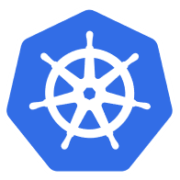



AKS Edge Essentials (AKS EE) – Solution architecture
AKS Edge Essentials cluster
Azure Linux VM built from EFLOW base
Windows VM (optional)
K8s/K3s Linux Worker
Azure containers
User containers
K8s/K3s Windows Worker
User containers
K8s/K3s Control Plane
Flux & other Azure agents
Linux containers
Windows containers
Azure Linux user
Arc-Connected cluster
Azure Linux kernel
Windows
Windows Host OS (with Hyper-V) as “Type-1” Hypervisor
Any infrastructure

Slide 31


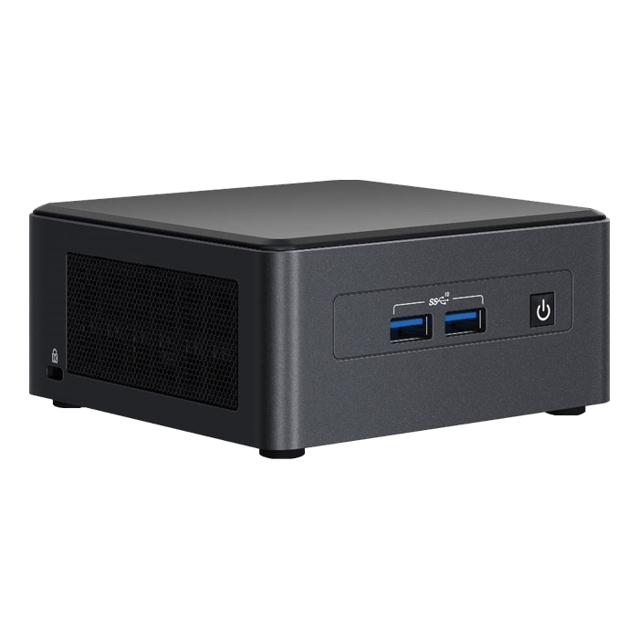
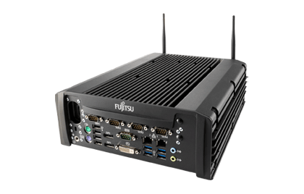
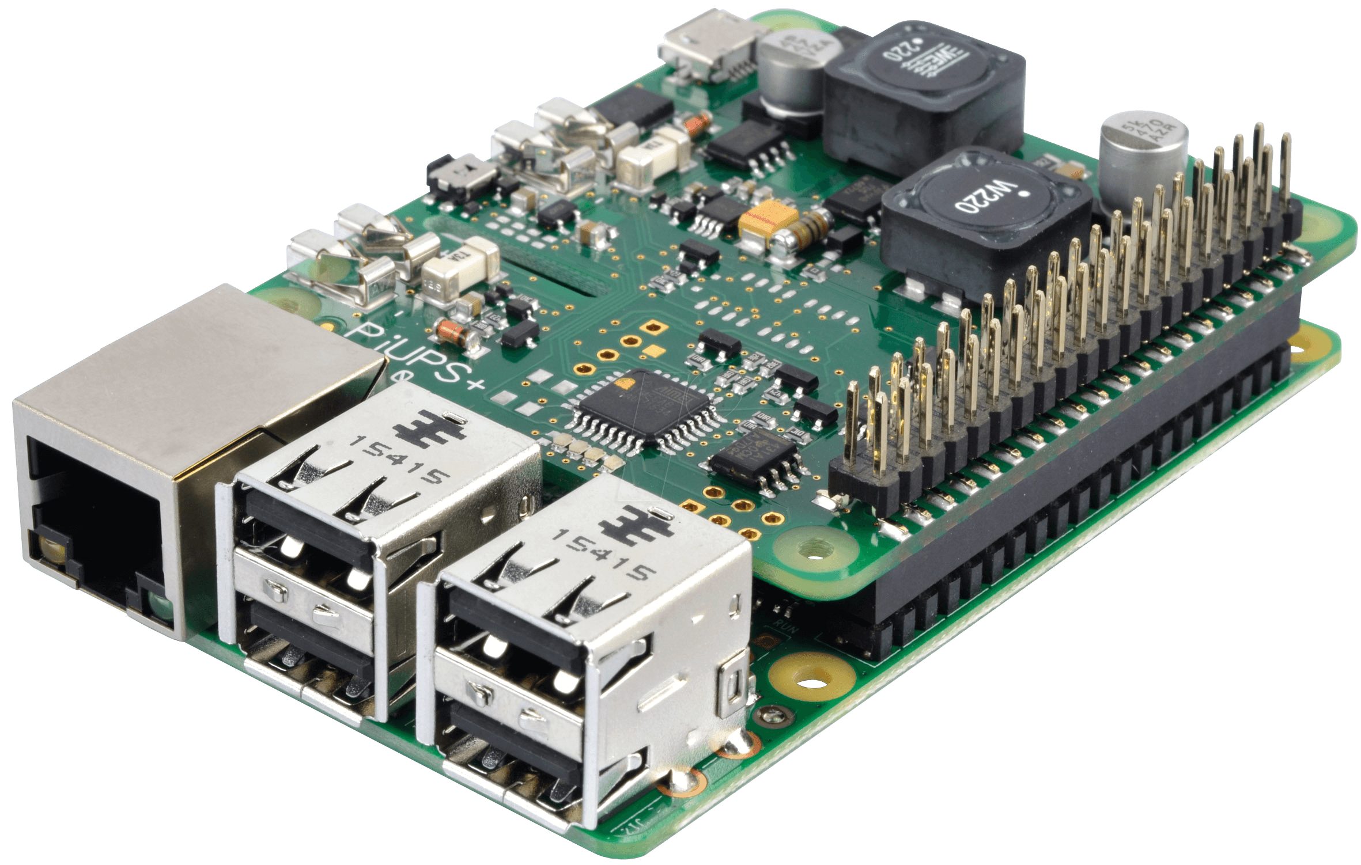
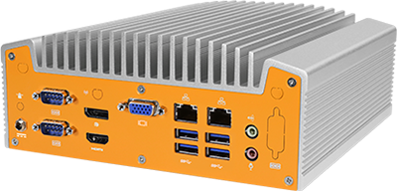
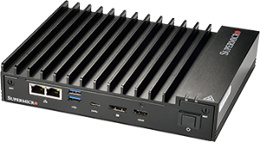
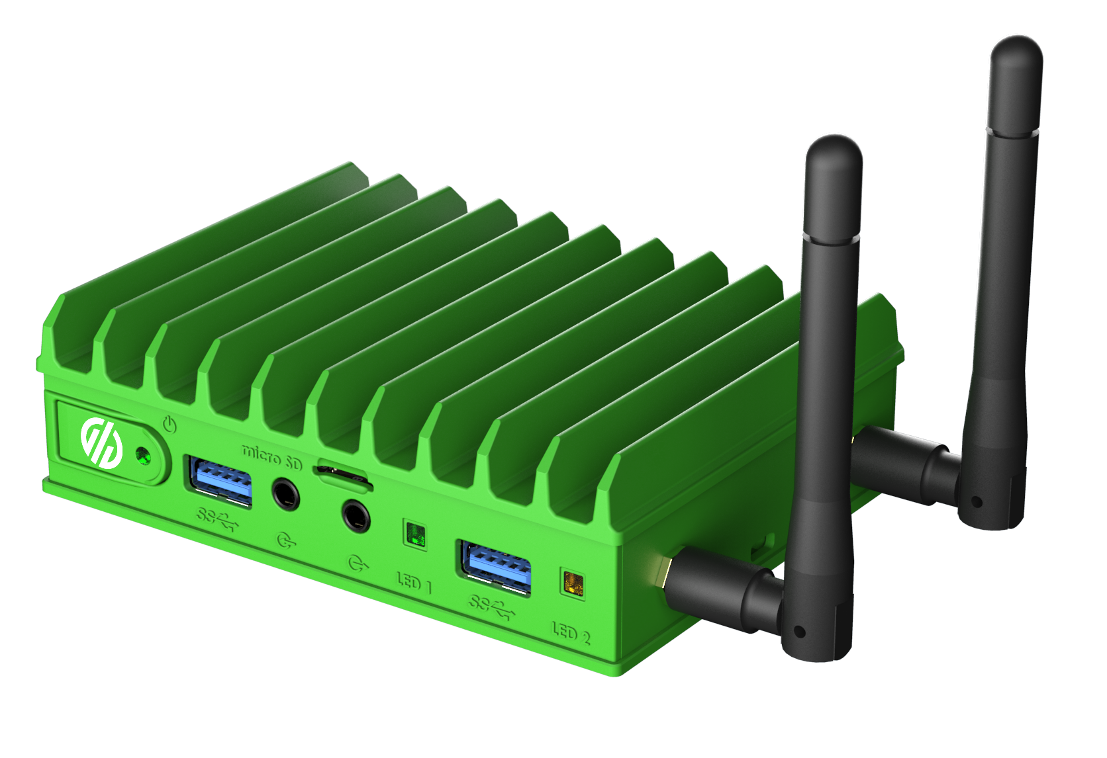
AKS enabled by Arc – Deployment options on Windows
Deploy your Linux and/or Windows containerized workloads
AKS hybrid on Windows
Azure Arc control plane to manage your cluster in Azure
Standard kubectl to manage your cluster using PowerShell
CNCF-conformant Kubernetes platform
PowerShell cmdlets and agents to enable provisioning and control of VMs and infra
Windows 10/11 ( IoT Enterprise / Enterprise / Pro ) and Windows Server
Edge computing devices (with 8GB+ RAM)

Slide 32



AKS Edge Essentials (AKS EE) – single-node cluster with internal virtual switch network architecture
Physical device
AKS EE single-node cluster
AKS EE Azure Linux VM
AKS EE Windows VM (optional)
K8s/K3s Linux Worker
K8s/K3s Windows Worker
K8s/K3s Control Plane
Azure Linux kernel
Windows
Linux VM Network Adapter (virtual)
192.168.0.2
Windows VM Network Adapter
(virtual)
192.168.0.3
aksedgesw-int
Hyper-V Internal Virtual Switch
Windows Hyper-V host
Hyper-V Host Network Adapter
(virtual NIC)
192.168.0.1
Network address translation (NAT)
Physical Network Adapter
10.0.0.2
External network – 10.0.0.0/24

Slide 33
AKS Edge Essentials (AKS EE) – multi-machine cluster with external virtual switch network architecture
AKS EE multi-node
cluster
Physical hardware – Device 1
Physical hardware – Device 2
AKS EE – Device 1
AKS EE – Device 2
AKS EE Azure Linux VM
AKS EE Windows VM (optional)
AKS EE Azure Linux VM
AKS EE Windows VM (optional)
K8s/K3s Linux Worker
K8s/K3s Windows Worker
K8s/K3s Linux Worker
K8s/K3s Windows Worker
K8s/K3s Control Plane
K8s/K3s Control Plane
Azure Linux kernel
Windows
Azure Linux kernel
Windows
Linux VM Network Adapter (virtual)
192.168.0.101
Windows VM Network Adapter
(virtual)
192.168.0.102
Linux VM Network Adapter (virtual)
192.168.0.103
Windows VM Network Adapter
(virtual)
192.168.0.104
aksedgesw-ext
Hyper-V External Virtual Switch
aksedgesw-ext
Hyper-V External Virtual Switch
Windows Hyper-V host
Physical Network Adapter
Physical Network Adapter
Windows Hyper-V host
Hyper-V host vEthernet network adapter 192.168.0.2
Hyper-V host vEthernet network adapter 192.168.0.3
External network – 192.168.0.0/24

Slide 34

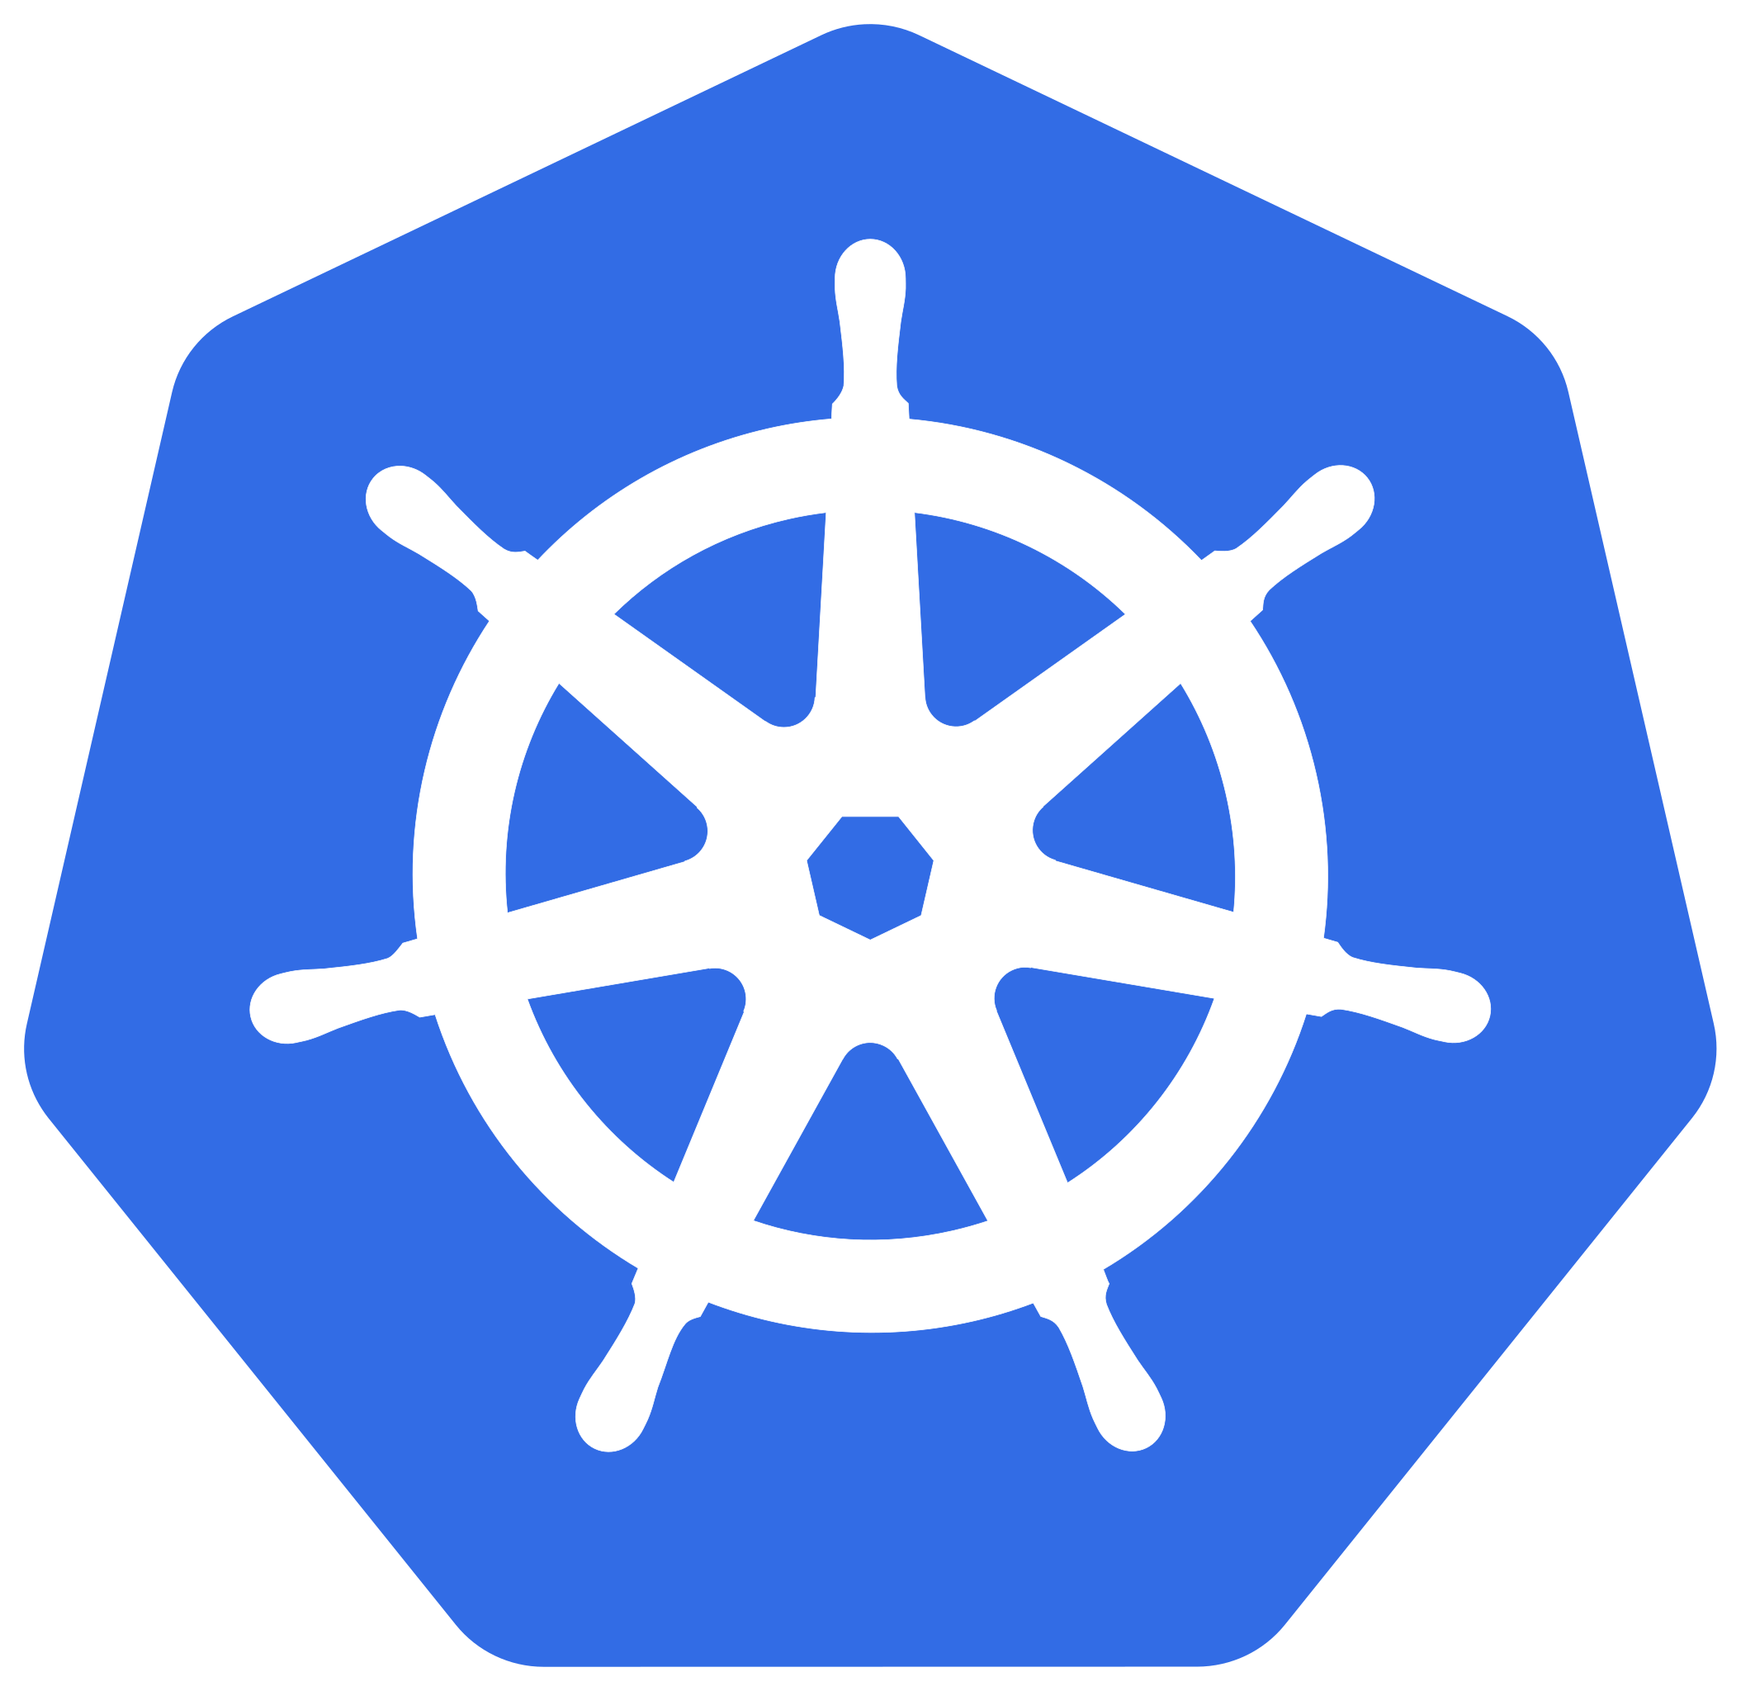


Azure IoT Operations enabled by Azure Arc
Edge
Cloud
Industrial assets
Arc-enabled Kubernetes
Cloud-based workloads
Azure IoT Operations
Edge-based workloads
Microsoft Fabric
Event Hub, Event Grid, and others
Azure operations, management and security spanning cloud and edge

Slide 35











Azure IoT Operations enabled by Azure Arc solution overview architecture
IT Management
IT Management
Edge
Information technology (IT) personnel
Operational technology (OT) personnel
Edge-located Arc-enabled Kubernetes cluster
Azure IoT Operations enabled by Azure Arc
OT Management
Azure IoT Operations experience
Deploy and send configurations per protocol
Akri services (preview)
Assets, Dataflow, and Schema management
Leaf device (assets) communication
Dataflows
Bring-your-own Connector
Asset discovery and configuration
Data Processor
OPC UA Connector
Sync asset, endpoint profiles and message schemas
OPC UA communication
Produce message schema
Consume message schema
Send industrial data
Azure Device Registry
Bidirectional communication with user workloads
Schema Registry
MQTT Broker
Ingestion of raw data and output of processed data
PowerBI
OPC UA server 01
OPC UA server 02
Arc-enabled services
(data services, app services, ML)
Data visualization
Kubernetes workloads
Microsoft Fabric
MQTT or Event Grid
Kafka or Azure Event Hubs
Azure Storage Azure Data Explorer (ADX)
Cloud-based
applications
Messaging and data
Data pipeline
Asset-01
Asset-02
Asset-03
Asset-04
Arc-enabled Infrastructure services (Azure Monitor, Microsoft Defender for Cloud, Azure Policy, etc.)
Azure control plane span across cloud and edge via Azure Arc

Slide 36

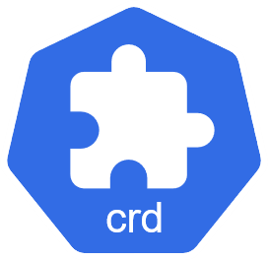
Azure IoT Operations – MQTT broker architecture
Edge-located Arc-enabled Kubernetes cluster
Azure IoT Operations MQTT broker
Industrial assets
MQTT Publish / Subscribe
Kubernetes Service
Backend Partitions
Backend Replicas
Replicate
Microsoft Fabric
MQTT or Event Grid
Kafka or Azure Event Hub
Azure Storage Azure Data Explorer (ADX)
Dataflows
(replicas)
Messaging
and data
MQTT Publish / Subscribe
Sharded by TopicID and SessionID
Distribute
MQTT Messages
Frontend Replicas
AuthN
Auth Service
Configuration from custom resource definition (CRD) and other resources
Diagnostics probe for self-test, synthetic traffic, and metrics emission
Health Manager
Kubernetes API
Read state
Kubernetes Operator
Kubernetes actions
request

Slide 37

Azure IoT Operations – Dataflows MQTT based architecture
5
User deploys Azure IoT Operations and creates Assets, dataflows and reference data sets
Microsoft Fabric
MQTT or Event Grid
Kafka or Azure Event Hub
Azure Storage Azure Data Explorer (ADX)
Industrial assets
Leaf device communication
Azure IoT Operation Experiences
OPC UA server
1
OPC UA communication
6
Edge-located Arc-enabled Kubernetes cluster
Dataflow CRD are created at the edge via ARM
OPC UA Connector
Dataflows
2
Read Dataflows and Reference Datasets CRD
Kubernetes Operator
3
OPC UA Broker standardizes Asset data and sends via MQTT
Set up the dataflow workloads
4
Dataflows Custom Resource Definition (CRD)
7
Write processed data
12
Replicas
8
MQTT Broker
Source
Data
Transform
Destination
Dataflow subscribes to Asset data topics
9
Reference Datasets Custom Resource Definition (CRD)
Use schema for reserialization
10
11
R/W Reference Data for enrichment
Schema Registry
Distributed State Store

Slide 38

Azure IoT Operations – Azure Device Registry (ADR) architecture
Operational technology (OT) personnel manage industrial assets and asset’s edge connectivity info
Edge
1
Edge-located Arc-enabled Kubernetes cluster
Azure IoT Operations Experience
Asset, Dataflow, and Schema management
Endpoint Profile Custom Resource Definition (CRD)
Azure IoT Operations enabled by Azure Arc
5
Akri services (preview)
Dataflows
Management via Azure portal, Azure CLI and API
Send industrial data
Assets Custom Resource Definition (CRD)
Asset discovery
Data Processor
Setup dataflow
Manage endpoint profile
OPC UA Connector
MQTT Broker
2
11
5
Retrieve message schema
Azure Resource Manager (ARM)
7
Generate message schema
12
OPC UA connector consumes Endpoint Profile and Asset resources
Schemas
Endpoint Profiles
9
ADR Arc cluster extension
8
3
Maintain sync between cloud and the edge
Bidirectional communication with user workloads
Schema Registry
Sync message schema between edge and cloud
Manage asset
10
Blob storage
Assets
Store schemas in persistent volume
Schema versions
6
OPC UA communication, Connect and receive asset data
Kubernetes workloads
Azure Container Storage enabled by Azure Arc
OPC UA server
4
Industrial assets
Sync assets and endpoint profiles as ARM resource via Arc
Azure control plane span across cloud and edge via Azure Arc

Slide 39

Azure IoT Operations – Layered Network Management (LNM) architecture (Public Preview)
Edge
Network level 0-1
Network level 2
Network level 3
Network level 4
Edge-located Arc-enabled Kubernetes cluster
Edge-located Arc-enabled Kubernetes cluster
Edge-located Arc-enabled Kubernetes cluster
Arc communication from lower layers to ARM over layered network
Azure IoT Operations enabled by Azure Arc
Azure IoT Operations enabled by Azure Arc
Azure IoT Operations enabled by Azure Arc
Azure Resource Manager (ARM)
Deploy and send configurations per protocol
Azure IoT Operations Layered Network Management
Azure IoT Operations Layered Network Management
Akri services
Data and control plan traffic from L2/L3
Leaf device (assets) communication
Bring-your-own Connector
OPC UA Connector
Data and control plan traffic from L2
Dataflows
Ingestion of raw data and output of processed data
Data Processor
Data from lower levels over layered network
OPC UA communication
MQTT Broker
MQTT Broker
MQTT Broker
Microsoft Fabric
MQTT or Event Grid
Kafka or Azure Event Hub
Azure Storage Azure Data Explorer (ADX)
Bidirectional communication with user workloads
Bidirectional communication with user workloads
Bidirectional communication with user workloads
Connector data
Kubernetes workloads
Kubernetes workloads
Kubernetes workloads
OPC UA server
Arc-enabled services
(e.g., data services, app services, ML)
Arc-enabled services
(e.g., Arc-enabled ML, etc.)
Arc-enabled services
(e.g., data services, app services, ML)
Industrial assets
Arc-enabled Infrastructure services (e.g. Azure Monitor, etc.)
Arc-enabled Infrastructure services (e.g. Azure Monitor, etc.)
Arc-enabled Infrastructure services (e.g. Azure Monitor, Microsoft Defender for Cloud, etc.)
Azure control plane span across cloud and edge via Azure Arc

Slide 40
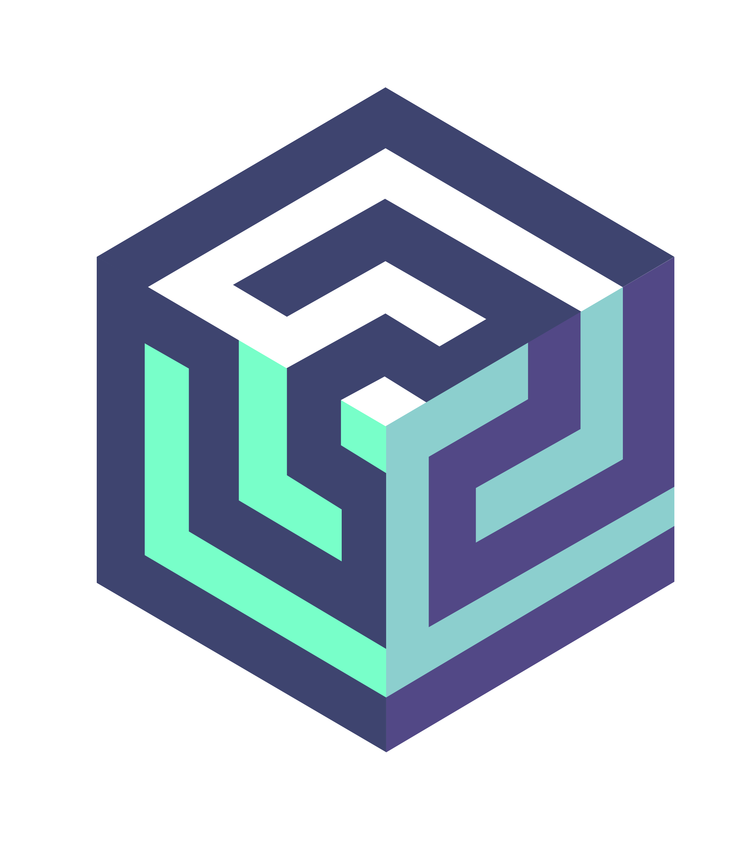
Open-Source Akri architecture
Edge-located Kubernetes cluster
Akri Kubernetes Provisioning manifest
Control Plane node
kind: Configuration
metadata:
name: akri-<protocol>
spec:
discoveryHandler:
name: <protocol>
brokerSpec:
containers:
- name: custom-broker
image: “ghcr.io/...”
...
etcd
Akri Configuration Custom Resource Definition (CRD)
Akri controller
Kubernetes scheduler
<protocol>
Configuration
Akri Instance Custom Resource Definition (CRD)
API server
<protocol>
Instance
Worker node
Leaf device (assets)
Custom Broker
<protocol> Discovery Handler
Akri agent
kubelet
<protocol>

Slide 41
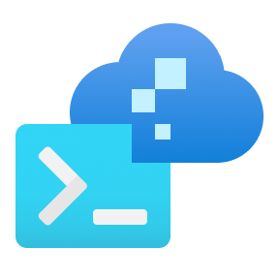









Azure Local – Solution reference architecture
Control plane Azure portal, ARM and Bicep templates, Azure CLI and tools
Microsoft
Entra ID
Azure Site Recovery
Azure Backup
Azure File Sync
Azure Update Manager
Additional Azure services integration via Azure Arc
Outbound access
to required URL endpoints
Azure Policy
Azure Monitor
Azure Key Vault
Microsoft Defender for Cloud
Traditional, non-containerized applications
Kubernetes-based
applications
Arc-enabled services
Arc VMs
Azure Virtual Desktop (session hosts)
Azure Kubernetes Service (AKS) enabled by Arc
Corp firewall
Azure Local
instance
Azure Local version releases
Hyper-V
Azure Arc
Resource Bridge
Storage Spaces Direct (S2D)
ToR Switch 1
East / West traffic
Switch / Router / Firewall
East / West traffic
ToR Switch 2
Validated Hardware
Scale: 1 to 16 machines
Azure Local machine 1
Azure Local machine 2
Azure Local machine 3
Azure Local machine 4
Azure Local machine 5
Azure Local machine 6
Solution categories
Premier Solutions for Azure Local
Integrated Systems for Azure Local
Validated Nodes for Azure Local

Slide 42
Azure Local – Cloud-based deployment architecture
Control plane Azure portal, ARM and Bicep templates, Azure CLI and tools
2
User sends cluster creation request to resource provider
Azure
Azure Resource Manager (ARM)
Azure Local resource provider
Arc-enabled servers resource providers
3
Arc extensions collect and send logs to Azure for remote troubleshooting with Microsoft support
Azure Local instance
DME sends server inventory to RP
Resource provider for Azure Local sends deployment information to Arc Lifecycle Manager extension
RP sends deployment information to Azure Edge Lifecycle Manager extension
6
1
4
Lifecycle Manager orchestration
Arc Device management extension (DME)
Arc Lifecycle Manager extension
Lifecycle Manager
Arc server agent
Network
4
Arc Resource Bridge (ARB)
Orchestrator
Update service
Arc extensions
5
Remote Support extension
Storage
Lifecycle Manager deploys Azure Resource Bridge which enables Arc VMs & AKS
Download Service
Arc Virtual machines (Arc VM)
Azure Kubernetes Service (AKS)
Health Service
Diagnostic and Telemetry extension
Machine Operating System

Slide 43





Azure Local – Arc virtual machine architecture
Arc extensions for Azure services (i.e. Azure Monitor, Azure Policy, Microsoft Defender, etc.) available for VM compliance, governance, and security
Azure Local Cloud Deployment
5
Azure services
VM Image Gallery
Azure Local instance
MOC agents and Arc Resource Bridge installed during cloud deployment, a Custom Location resource is created in Azure that points to the specific Azure Local instance.
Virtual machines as Arc VMs
User creates VM using VM image, network, and storage, using Custom Location as deployment target. VMs are configured automatically with Arc agent
User downloads image from Azure Marketplace on to Azure Local instance
3
1
4
Arc Resource Bridge (ARB)
User creates logical networks and storage paths to store VM images
Cluster Shared Volume (CSV)
Network
2
Storage path
OS image
Virtual network
Custom Location
vNIC
MOC Agent Clustered Service
Machine Operating System
Machine Operating System
Machine Operating System
MOC agent
MOC agent
MOC agent
Azure Local machine
Azure Local machine
Azure Local machine

Slide 44









Azure Local – Monitoring flow architecture
User’s metrics consumptions channels
Azure Workbooks visualization
Standard metrics
Metrics Explorer
Dashboards
Azure workbooks
Notification channels
Microsoft Customer Service and Support (CSS)
Azure Monitor
Azure Log Analytics workspace
Alert rules
Telemetry,
Diagnostics, Metrics
Metric Types and Metric Aggregations
Kusto query
Resource/Scope
Actions Groups
Signal
Data Collection Rules (DCRs)
Conditions
Telemetry,
Diagnostics, Metrics
Events and performance counters
Azure Local instance
Telemetry and Diagnostics extensions
Azure Monitor Windows Agent extension
Telemetry and Diagnostics extension
Azure Monitor Windows Agent extension
Telemetry and Diagnostics extension
Azure Monitor Windows Agent extension
Alerts extension
Alerts extension
Alerts extension
Machine Operating System
Machine Operating System
Machine Operating System
Azure Local machine
Azure Local machine
Azure Local machine

Slide 45




Azure Local – Storage architecture
Cloud Deployment automatically configures storage volumes with recommended resiliency
Cloud Deployment
Windows Admin Center (WAC)
PowerShell
Cluster-shared volumes can be managed via Portal, WAC and PowerShell
Azure Local instance
Arc VMs
Live Migration across Azure Local machines
Instance-wide storage pool
Storage Spaces Virtual Disk
VMs can read/write to a VHD/X file on any cluster-shared volume (CSV)
Storage Spaces Virtual Disk
Storage Spaces Virtual Disk
UserStorage_1 (CSV)
UserStorage_2 (CSV)
UserStorage_3 (CSV)
Resilient File System (ReFS)
Resilient File System (ReFS)
Resilient File System (ReFS)
VHD / VHDX
VHD / VHDX
VHD / VHDX
S2D writes multiple copies to persistent cache, using the physical flash drives in the instance machines
Machine Operating System
Machine Operating System
Machine Operating System
In-memory read cache
In-memory read cache
In-memory read cache
Azure Local machine
Azure Local machine
Azure Local machine
Software-defined storage with mirrored resiliency provide by Software Bus Layer (SBL)
Storage pool of local drives with Storage Spaces Direct (S2D)
Capacity-tier
Cache-tier
Capacity-tier
Cache-tier
Capacity-tier
Cache-tier
SSD
SSD
SSD
SSD
NVMe
NVMe
SSD
SSD
SSD
SSD
NVMe
NVMe
SSD
SSD
SSD
SSD
NVMe
NVMe

Slide 46

Azure Local – Storage Switched 2+ machines, Dual TOR, dedicated Storage, converged Management + Compute, logical connectivity
(simplified architecture)
Switch / Router / Firewall
Link Aggregation
Management, Compute, and Storage TOR 1 Network switch
Management, Compute, and Storage TOR 2 Network switch
Management, Compute, and Storage VLANs
Network ATC: Management and Compute Intent
Azure Local instance
10GB+
Ethernet Port
Management vNIC
10GB+
Ethernet Port
10GB+
Ethernet Port
Management vNIC
10GB+
Ethernet Port
Management + Compute NICs Switch Embedded Team (SET) and Virtual Filtering Platform (VFP)
Management + Compute NICs Switch Embedded Team (SET) and Virtual Filtering Platform (VFP)
Azure Local machine 1
Azure Local machine n
Scale: 2 to 16 machines
RDMA NICs | Storage Intent
RDMA NICs | Storage Intent
10GB+
Ethernet Port
SMB1
10GB+
Ethernet Port
SMB2
10GB+
Ethernet Port
SMB1
10GB+
Ethernet Port
SMB2
Network ATC: Storage Intent

Slide 47
Azure Local – Storage Switched 2+ machines, Dual TOR, dedicated Storage, converged Management + Compute, physical connectivity
(simplified architecture)
Switch / Router / Firewall
Link Aggregation
Management, Compute, and Storage TOR 1 Network switch
Management, Compute, and Storage TOR 2 Network switch
Azure Local instance
10GB+
Ethernet Port
10GB+
Ethernet Port
10GB+
Ethernet Port
SMB1
10GB+
Ethernet Port
SMB2
10GB+
Ethernet Port
10GB+
Ethernet Port
10GB+
Ethernet Port
SMB1
10GB+
Ethernet Port
SMB2
Management + Compute NICs Switch Embedded Team (SET)
RDMA NICs
Management + Compute NICs Switch Embedded Team (SET)
RDMA NICs
Azure Local machine 1
Azure Local machine n
Scale: 2 to 16 machines

Slide 48
Azure Local – Three-machines storage switchless, dual link, dual TOR network architecture, logical connectivity
(simplified architecture)
Switch / Router / Firewall
Network switch
Network switch
Trunk Port
Management and Compute networks
Trunk Port
1GB+
Ethernet Port
1GB+
Ethernet Port
1GB+
Ethernet Port
1GB+
Ethernet Port
1GB+
Ethernet Port
1GB+
Ethernet Port
Azure Local instance
Management + Compute Intent
Management + Compute Intent
Management + Compute Intent
Azure Local machine 1
Azure Local machine 2
Azure Local machine 3
RDMA NICs | Storage Intent
RDMA NICs | Storage Intent
RDMA NICs | Storage Intent
10GB+
Ethernet Port
IP: 10.0.1.1
10GB+
Ethernet Port
IP: 10.0.2.1
10GB+
Ethernet Port
IP: 10.0.3.1
10GB+
Ethernet Port
IP: 10.0.4.1
10GB+
Ethernet Port
IP: 10.0.1.2
10GB+
Ethernet Port
IP: 10.0.2.2
10GB+
Ethernet Port
IP: 10.0.5.2
10GB+
Ethernet Port
IP: 10.0.6.2
10GB+
Ethernet Port
IP: 10.0.3.3
10GB+
Ethernet Port
IP: 10.0.4.3
10GB+
Ethernet Port
IP: 10.0.5.3
10GB+
Ethernet Port
IP: 10.0.6.3
Subnet 1: 10.0.1.x/24
Subnet 3: 10.0.5.x/24
Subnet 2: 10.0.2.x/24
Subnet 6: 10.0.6.x/24
Subnet 5: 10.0.3.x/24
Subnet 4: 10.0.4.x/24
Storage Network ATC intent: VLAN 711, AutoIP=False

Slide 49
Azure Local – Three-machines storage switchless, dual link, dual TOR network architecture, physical connectivity
(simplified architecture)
Switch / Router / Firewall
Network switch
Link Aggregation
Network switch
1GB+
Ethernet Port
1GB+
Ethernet Port
1GB+
Ethernet Port
1GB+
Ethernet Port
1GB+
Ethernet Port
1GB+
Ethernet Port
Azure Local instance
Management + Compute NICs Switch Embedded Team (SET)
Management + Compute NICs Switch Embedded Team (SET)
Management + Compute NICs Switch Embedded Team (SET)
Azure Local machine 1
Azure Local machine 2
Azure Local machine 3
RDMA NICs
RDMA NICs
RDMA NICs
10GB+
Ethernet Port
SMB1
10GB+
Ethernet Port
SMB2
10GB+
Ethernet Port
SMB3
10GB+
Ethernet Port
SMB4
10GB+
Ethernet Port
SMB1
10GB+
Ethernet Port
SMB2
10GB+
Ethernet Port
SMB3
10GB+
Ethernet Port
SMB4
10GB+
Ethernet Port
SMB1
10GB+
Ethernet Port
SMB2
10GB+
Ethernet Port
SMB3
10GB+
Ethernet Port
SMB4

Slide 50
Azure Local – Fully converged network architecture
Azure Local instance networks key
Network interface requirements
All traffic types (management, compute and storage) share the same physical network adapter ports in a fully converged host networking pattern
One port per machine connected to each switch, all ports configured as Trunk ports, (two links per machine)
Management VLAN
Compute VLAN(s)
Multiple Compute Logical Networks and VLAN(s) can be configured for VM, AKS Cluster or AVD workloads
Storage Network 1 VLAN
Storage Network 2 VLAN
Minimum 10GB speed required for interfaces when using the fully converged network topology
Remote direct memory access (RDMA) capable NICs required
25GB+ recommended for increased performance and scalability
Switch / Router / Firewall
Network switch
Network switch
Trunk Port
Azure Local instance networks
Trunk Port
Network ATC: Management, Compute and Storage Intent
Azure Local instance
10GB+
Ethernet Port
10GB+
Ethernet Port
10GB+
Ethernet Port
10GB+
Ethernet Port
10GB+
Ethernet Port
10GB+
Ethernet Port
Azure Local machine 1
Azure Local machine 2
Azure Local machine 3
Management + Compute + Storage Intent
Management + Compute + Storage Intent
Management + Compute + Storage Intent

Slide 51
Azure Local – Three-machines switchless dual link, dual TOR network architecture
Azure Local instance networks key
Network interface requirements
Management and Compute Intent converged using a switch embedded team (SET) of 2 NICs and Trunk port configuration
Multiple Compute logical networks with different VLAN IDs can be configured for VM, AKS Cluster or AVD workloads
Single VLAN for the Management network
Storage Intent uses 6 x separate layer 2 networks, with no default gateway configured on the ethernet interface settings
Switch / Router / Firewall
Management and Compute Intent requires minimum 2 x 1GB+ ports, with one connected to each switch
Converged using a switch embedded team (SET) to provide resiliency and traffic load balancing
Network switch
Network switch
Network interface requirements
Storage traffic has two (dual) links for redundancy
Dedicated 4 x 10GB (or higher) remote direct memory access (RDMA) capable ports
Trunk Port
Management and Compute networks
Trunk Port
1GB+
Ethernet Port
1GB+
Ethernet Port
1GB+
Ethernet Port
1GB+
Ethernet Port
1GB+
Ethernet Port
1GB+
Ethernet Port
Azure Local instance
Management + Compute Intent
Management + Compute Intent
Management + Compute Intent
Azure Local machine 1
Azure Local machine 2
Azure Local machine 3
RDMA NICs | Storage Intent
RDMA NICs | Storage Intent
RDMA NICs | Storage Intent
10GB+
Ethernet Port
IP: 10.0.1.1
10GB+
Ethernet Port
IP: 10.0.2.1
10GB+
Ethernet Port
IP: 10.0.3.1
10GB+
Ethernet Port
IP: 10.0.4.1
10GB+
Ethernet Port
IP: 10.0.1.2
10GB+
Ethernet Port
IP: 10.0.2.2
10GB+
Ethernet Port
IP: 10.0.5.2
10GB+
Ethernet Port
IP: 10.0.6.2
10GB+
Ethernet Port
IP: 10.0.3.3
10GB+
Ethernet Port
IP: 10.0.4.3
10GB+
Ethernet Port
IP: 10.0.5.3
10GB+
Ethernet Port
IP: 10.0.6.3
Subnet 1: 10.0.1.x/24
Subnet 3: 10.0.5.x/24
Subnet 2: 10.0.2.x/24
Subnet 6: 10.0.6.x/24
Subnet 5: 10.0.3.x/24
Subnet 4: 10.0.4.x/24
Storage Network ATC intent: VLAN 711, AutoIP=False

Slide 52
Azure Local – Two-machines switchless dual link network architecture
Network interface requirements
Azure Local instance networks key
Management and Compute Intents requires minimum 2 x 1GB+ NICs, with one connected to each switch
Converged using a switch embedded team (SET) to provide resiliency and traffic load balancing
Management and Compute Intents converged using a switch embedded team (SET) of 2 NICs and Trunk port configuration
Multiple Compute Logical Networks and VLAN(s) can be configured for VM, AKS Cluster or AVD workloads
Single VLAN for Management network
Storage Intents use 2 x separate non-routable (layer 2) networks, with no default gateway configured on the ethernet interfaces
Switch / Router / Firewall
Network switch
Network switch
Network interface requirements
Storage Intent has dual links for redundancy
Dedicated 2 x 10GB (or higher) remote direct memory access (RDMA) capable NICs per machine
Trunk Port
Network ATC: Management and Compute
Trunk Port
1GB+
Ethernet Port
1GB+
Ethernet Port
1GB+
Ethernet Port
1GB+
Ethernet Port
Azure Local instance
Azure Local machine 1
Azure Local machine 2
Management + Compute Intent
Management + Compute Intent
RDMA NICs | Storage Intent
RDMA NICs | Storage Intent
10GB+
Ethernet Port
10GB+
Ethernet Port
10GB+
Ethernet Port
10GB+
Ethernet Port
Direct peer-to-peer connections for storage replication traffic
Storage Network 1
Storage Network 2
Network ATC: Storage Intent

Slide 53
Azure Local – Four-node storage switchless, dual link logical connectivity (simplified architecture)
Switch / Router / Firewall
Network switch
Network switch
Trunk Port
Trunk Port
Management and Compute networks
1GB+
Ethernet Port
1GB+
Ethernet Port
1GB+
Ethernet Port
1GB+
Ethernet Port
1GB+
Ethernet Port
1GB+
Ethernet Port
1GB+
Ethernet Port
1GB+
Ethernet Port
Azure Local machine 1
Azure Local machine 2
Azure Local machine 3
Azure Local machine 4
Management + Compute Intent
Management + Compute Intent
Management + Compute Intent
Management + Compute Intent
Storage Network ATC intent: VLAN 711, AutoIP=False
RDMA NICs | Storage Intent
RDMA NICs | Storage Intent
RDMA NICs | Storage Intent
RDMA NICs | Storage Intent
10GB+
Ethernet
Port
IP: 10.0.1.2
10GB+
Ethernet
Port
IP: 10.0.2.2
10GB+
Ethernet
Port
IP: 10.0.3.2
10GB+
Ethernet
Port
IP: 10.0.4.2
10GB+
Ethernet
Port
IP: 10.0.5.2
10GB+
Ethernet
Port
IP: 10.0.6.2
10GB+
Ethernet
Port
IP: 10.0.1.3
10GB+
Ethernet
Port
IP: 10.0.2.3
10GB+
Ethernet
Port
IP: 10.0.7.2
10GB+
Ethernet
Port
IP: 10.0.8.2
10GB+
Ethernet
Port
IP: 10.0.9.2
10GB+
Ethernet
Port
IP: 10.0.10.2
10GB+
Ethernet
Port
IP: 10.0.7.3
10GB+
Ethernet
Port
IP: 10.0.8.3
10GB+
Ethernet
Port
IP: 10.0.3.3
10GB+
Ethernet
Port
IP: 10.0.4.3
10GB+
Ethernet
Port
IP: 10.0.11.2
10GB+
Ethernet
Port
IP: 10.0.12.2
10GB+
Ethernet
Port
IP: 10.0.9.3
10GB+
Ethernet
Port
IP: 10.0.10.3
10GB+
Ethernet
Port
IP: 10.0.11.3
10GB+
Ethernet
Port
IP: 10.0.12.3
10GB+
Ethernet
Port
IP: 10.0.5.3
10GB+
Ethernet
Port
IP: 10.0.6.3
Subnet 1: 10.0.1.x/24
Subnet 2: 10.0.2.x/24
Subnet 3: 10.0.3.x/24
Subnet 4: 10.0.4.x/24
Subnet 10: 10.0.10.x/24
Subnet 5: 10.0.5.x/24
Subnet 9: 10.0.9.x/24
Azure Local instance
Subnet 6: 10.0.6.x/24
Subnet 7: 10.0.7.x/24
Subnet 8: 10.0.8.x/24
Subnet 11: 10.0.11.x/24
Subnet 12: 10.0.12.x/24

Slide 54






Azure Virtual Desktop on Azure Local reference architecture
Control plane Azure portal, ARM and Bicep templates, Azure CLI and tools
Microsoft
Entra ID
User authentication and token exchange during login
Azure Virtual Desktop
Azure Site Recovery
Azure Backup
Azure File Sync
Azure Update Manager
Additional Azure services integration via Azure Arc
2
Azure Policy
Azure Monitor
Azure Key Vault
Microsoft Defender for Cloud
Hybrid identity synchronization between on-premises AD DS and cloud-based Entra ID for local authentication and cloud access
Session initiation to Azure Virtual Desktop in Azure from user’s device
3
User devices
4
Azure Virtual Desktop client
Azure Virtual Desktop agent connects to Azure, handling session brokering, user sessions, metering, and diagnostics
1
Active Directory Domain Services
Arc agent integration for additional governance, monitoring, and lifecycle management
RDP Shortpath (with VPN) or Direct UDP connection
User credential validation, group policy application
Arc VMs
Azure Virtual Desktop (session hosts)
User profile storage location:
Dedicated NAS / SMB file share storage (Preferred option) OR
S2D pool on Azure Local instance
Azure Virtual Desktop agent
Azure Arc agent
Azure Local instance
5
Network attached storage OR SMB File Share
Azure Local version releases
User profiles
Hyper-V
Azure Arc
Resource Bridge
Storage Spaces Direct (S2D)
User profiles

Slide 55


Azure Migrate for Azure Local – Solution architecture (Public Preview)
Storage Accounts
Azure Migrate
Azure Resource Manager
Azure Migrate Project
Azure Local Resource Provider
Azure Key Vault
SSL/443
SSL/443
On-premises
Control plane (VMware vCenter or Hyper-V server)
Azure Local instance
Azure Migrate target appliance
Arc resource bridge (ARB)
Arc VMs
VMware vSphere or Hyper-V source cluster
Infrastructure
Virtual Machine Templates
Virtual Machines
Azure Migrate source appliance
Storage
Hyper-V Failover Cluster Manager
Virtual Networks
VM
VM
VM
Logical Networks (LNET)

Slide 56


Azure Migrate – Setup and Discovery (Public Preview)
Azure Migrate
2
A new Azure Migrate project is created and generated with both source and target keys
New Project
Source appliance discovers VMs in source cluster, creates an inventory, and sends the list to the Azure Migrate project where the user can select which of the VMs to migrate
4
Source key
Target key
A virtual machine in source environment is provisioned and installed with Azure Migrate appliance, followed by appliance linkage to Azure Migrate project with source key
A virtual machine is provisioned in target environment, and installed with Azure Migrate appliance followed by appliance linkage to Azure Migrate project with target key
3
5
On-premises
Windows Server virtual machines
Azure Migrate source appliance (Windows Server 2022)
Azure Migrate target appliance (Windows Server 2022)
Windows Client virtual machines
Arc resource bridge (ARB)
User configures a storage path and LNET that the migrated VMs will use
1
Linux virtual machines
1
Cluster Shared Volume (CSV)
Logical Networks
(LNET)
Storage Path
VMware vSphere or Hyper-V source cluster
Azure Local instance

Slide 57
Azure Migrate – Replication (Public Preview)
Azure Migrate
New Project
User selects virtual machines for initial replication and configures target settings for the virtual machines, including compute, disk resizing, LNET, and storage path, then initiates replication process
1
On-premises
Windows Server virtual machines
Azure Migrate source appliance (Windows Server 2022)
Azure Migrate target appliance (Windows Server 2022)
Windows Client virtual machines
Arc resource bridge (ARB)
2
Initial replication is initiated to copy all disks and transfer logs from source to target cluster
Cluster Shared Volume (CSV)
Logical Networks (LNET)
Linux virtual machines
Storage Path
Initial replication
VMware vSphere or Hyper-V source cluster
Azure Local instance
Delta replication (hourly)
3
Delta replication copies any new changes during or after initial replication

Slide 58
Azure Migrate – Migration (Public Preview)
Azure Migrate
1
Once replication is complete, user initiate a migration from Azure Migrate in the Azure portal
New Project
ITOps
On-premises
Linux virtual machines
Windows Client virtual machines
3
User turns off source virtual machine after final delta replication
Windows Server virtual machines
Windows Server virtual machines
Azure Migrate source appliance (Windows Server 2022)
Azure Migrate target appliance (Windows Server 2022)
Arc resource bridge (ARB)
4
Windows Client virtual machines
ARB starts migrated virtual machine on target cluster
Cluster Shared Volume (CSV)
Logical Networks (LNET)
Linux virtual machines
Storage Path
VMware vSphere or Hyper-V source cluster
Delta replication (hourly)
Azure Local instance
2
Once migration starts, one final delta replication is completed

Slide 59
Azure Migrate for Azure Local – Decommission (Public Preview)
Azure Migrate
New Project
ITOps
On-premises
Linux virtual machines
1
2
Upon completion, user deletes both source and target Azure Migrate appliance
2
Windows Client virtual machines
User completes migration and decommission source virtual machines
Windows Server virtual machines
Windows Server virtual machines
Azure Migrate source appliance (Windows Server 2022)
Azure Migrate target appliance (Windows Server 2022)
Windows Client virtual machines
Arc resource bridge (ARB)
Cluster Shared Volume (CSV)
Logical Networks (LNET)
Linux virtual machines
Storage Path
VMware vSphere or Hyper-V source cluster
Azure Local instance

Slide 60


Azure Container Storage enabled by Azure Arc (ACSA) – Solution Architecture
Edge
Cloud
PowerBI
Edge located Arc-enabled Kubernetes
Kubernetes-based application
Data visualization
Azure storage services
Generated application data
File data flow
Azure Block Blob storage account
Azure Container Storage enabled by Azure Arc (ACSA)
ACSA writes out using Blob storage SDK for copying file-based data to Azure storage services
Azure Data Lake Storage (ADLS) Gen2
Local storage
Cloud Ingest
File-based data to blob conversion
Azure OneLake

Slide 61
Azure Container Storage enabled by Azure Arc (ACSA) – Edge Volumes Solution Architecture
Local Shared Edge Volumes
Storage local to your cluster
Cloud connection independent
Cloud Ingest Edge Volumes
Disconnection tolerant data ingest
Purge from edge once uploaded
Configurable
Edge-located Arc-enabled Kubernetes cluster
Kubernetes-based application
App service
App service
App service
PowerBI
Generated application data
Data visualization
Azure Container Storage
enabled by Azure Arc cluster
Azure storage services
File data flow
3-way replication for high-availability and fault tolerance
Cloud Volume
Azure Block Blob storage account
Local Shared Volume 0
Ingest Subvolume 0
Blob SDK data flow
Local Shared Volume 1
Ingest Subvolume 1
Azure Data Lake Storage (ADLS) Gen2
Local Shared Volume n
Ingest Subvolume n
Azure OneLake
Worker node 0
Worker node 1
Worker node n
Physical disks
Physical disks
Physical disks

Slide 62
Azure Container Storage enabled by Azure Arc (ACSA) – Using Edge Volumes Together
Edge-located Arc-enabled Kubernetes cluster
Kubernetes-based application
App service
App service
App service
Generated application data
File data flow
File data flow
User or application is copying files
PowerBI
Data visualization
Azure Container Storage enabled by Azure Arc (ACSA)
Azure OneLake
Local Shared Volume
Cloud Volume
Ingest Subvolume
Blob SDK data flow

Slide 63
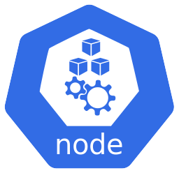


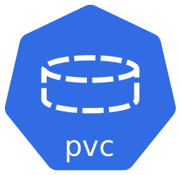

Azure Container Storage enabled by Azure Arc (ACSA) – Storage options architecture
Edge-located Arc-enabled Kubernetes cluster
Linux/Windows Worker node
Storage Class (SC)
Linux/Windows Worker node
Pod
Pod
PVC uses SC to dynamically provision PV using a PVC
Persistent Volume Claim (PVC)
Persistent Volume Claim (PVC)
Persistent Volume (PV)
Pod uses a PVC to allocate storage from the PV
Storage infrastructure type selected at deployment time
ACSA Arc cluster extension
Used storage infrastructure based on Kubernetes StorageClass
Microsoft ACSA StorageClass provisioner
User-owned external plugins StorageClass provisioners
User-owned remote on-premises StorageClass provisioners
User-owned local Kubernetes worker node StorageClass provisioners
Azure Container Storage enabled by Azure Arc 1st party Azure service integration
Third-party plugins
Network-based storage
Directly attached storage
(NVMe, SSD, HDD)

Slide 64


Azure AI Video Indexer enabled by Arc – Solution architecture (Public Preview)
Edge-located Arc-enabled Kubernetes cluster
Video transformations
Redaction
Editing
Encoding
Experiences
Widgets
Web portal
Search
APIs
Trial
Azure IoT Operations
Video type
Media type
Indexing service
1st party AI post-processing
3rd party AI post-processing
Azure IoT Akri
Recorded
Audio
Basic Video and Audio
Future 1st party processing capabilities
Bring-your-own Custom AI model
Live
(*Planned)
Video
AI integration (LLM / SLM / Computer vision)
Azure OpenAI
3rd party or OSS LLM and SLM (Meta Llama 2, Microsoft Phi-2, Mistral AI)
Project Florence – Microsoft AI Cognitive Services computer vision
Media stream
Azure AI Video Indexer Arc cluster extension

Slide 65


Azure AI Video Indexer enabled by Arc – AI models mapping overview
Audio analysis – Transcoding
Vision analysis – Transcoding
Multiple language identification
language identification
Voice activity detection
Emotion recognition
Audio effects
Textual content moderation
OCR
Scene segmentation
Face detection
Observed people
Labels
Object detection
Rolling credits detection
Visual content moderation
Transcription
Speaker diarization
Translation
Clapperboard detection
Keyframe extraction
Face grouping
Clothing detection
Sentiment analysis
Shot segmentation
Best face selection
Featured clothing
Mentioned brands
Digital patterns
Face identification
Matched person
Mentioned people
Textless material
Mentioned locations
Keyword extractions
Topic modeling
Bring-your-own Custom AI model
Azure AI Video Indexer

Slide 66
Azure AI Video Indexer enabled by Arc – Dual-AI modality (Audio+Vision) mapping overview
Audio analysis – Transcoding
Vision analysis – Transcoding
Multiple language identification
language identification
Voice activity detection
Emotion recognition
Audio effects
Textual content moderation
OCR
Scene segmentation
Face detection
Observed people
Labels
Object detection
Rolling credits detection
Visual content moderation
Transcription
Speaker diarization
Translation
Clapperboard detection
Keyframe extraction
Face grouping
Clothing detection
Sentiment analysis
Shot segmentation
Best face selection
Featured clothing
Mentioned brands
Digital patterns
Face identification
Matched person
Mentioned people
Textless material
Mentioned locations
Keyword extractions
Topic modeling
Bring-your-own Custom AI model
Azure AI Video Indexer

Slide 67
Azure AI Video Indexer enabled by Arc – Cloud + Edge AI models mapping overview
Audio analysis – Transcoding
Vision analysis – Transcoding
Multiple language identification
language identification
Voice activity detection
Emotion recognition
Audio effects
Textual content moderation
OCR
Scene segmentation
Face detection
Observed people
Labels
Object detection
Rolling credits detection
Visual content moderation
Transcription
Speaker diarization
Translation
Clapperboard detection
Keyframe extraction
Face grouping
Clothing detection
Sentiment analysis
Shot segmentation
Best face selection
Featured clothing
Mentioned brands
Digital patterns
Face identification
Matched person
Mentioned people
Textless material
Mentioned locations
Keyword extractions
Topic modeling
Bring-your-own Custom AI model
Azure AI Video Indexer AND Azure AI Video Indexer enabled by Arc

Slide 68
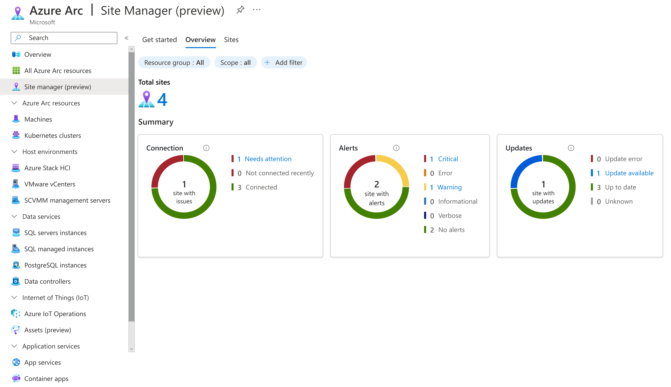
Azure Arc site manager – Solution architecture (Public Preview)
Azure Arc site manager Unified operations, management, compliance, security, and governance across locations
Azure Monitor
Azure Update Manager
Future operations and management Azure services integrations
Arc site A
Arc site B
Arc site n
Arc-enabled servers
Azure Local instances
Azure IoT Operations assets
Arc-enabled servers
Azure Local instances
Arc-enabled Kubernetes
Azure Local instances
Azure IoT Operations assets
Azure Resource Manager (ARM)
Azure control plane span across cloud and edge via Azure Arc
Physical site – location A
Physical site – location B
Physical site – location n
Physical servers
Azure Local instances
Assets
Servers and virtual machines
Azure Local instances
Kubernetes clusters
Azure Local instances
Assets

Slide 69

Arc resource bridge (ARB) – Solution architecture
VMware vSphere ARM resources
SCVMM ARM resources
Azure Local instance ARM resources
vCenter server
SCVMM Management server
Azure Local VM enabled by Azure Arc
Resource Pools / Clusters / Hosts
SCVMM Clouds
Hyper-V (HV) virtual networks
VM Templates
vSphere VMs
VM Templates
Hyper-V VMs
VM Templates
Hyper-V VMs
vSphere Networks
Hyper-V (HV) virtual networks
Custom location mapping
Custom location mapping
Custom location mapping
ARB ARM resource
Private cloud environment
Arc resource bridge
Arc resource bridge
Arc resource bridge
Custom location
Custom location
Custom location
Arc-enabled Kubernetes cluster extensions
Arc-enabled Kubernetes cluster extensions
Arc-enabled Kubernetes cluster extensions
Management endpoint
Management endpoint
Management endpoint
VMware vSphere environment
SCVMM environment
Azure Local instance
vCenter server
SCVMM Management server
Azure Local instance control plane
Resource Pools / Clusters / Hosts
SCVMM Clouds
Hyper-V (HV) virtual networks
VM Templates
vSphere VMs
VM Templates
Hyper-V VMs
VM Templates
Hyper-V VMs
vSphere Networks
Hyper-V (HV) virtual networks

Slide 70

Arc resource bridge (ARB) – Deployment workflow architecture
Virtual environment admin
ARB artifact download sources
Required Azure endpoint for Arc operations
1
Install Arc appliance extension for Azure CLI
Microsoft Container Registry (MCR)
Arc-enabled Kubernetes
Container Image Registry
Guest Notification Service
Arc Cluster Connect Service
Deployment machine
Linux Geneva Service
Hybrid Identity Service
Azure Container Registry (ACR)
Microsoft Packages Manager
Event Data Service
Azure Arc Agent
Build configuration file for ARB
2
Azure Health Data Services
Azure Graph
5e
Kubernetes Virtual Appliance (KVA) Management Operator Container Image Registry
Azure Blob Storage
Azure CLI
Azure Diagnostic Data Services
Azure Resource Manager
Create ARB ARM resource
3
Download VM image
Microsoft Secure File Storage
ARB ARM resource
4
Upload VM image
Virtual environment infrastructure control plane (VMware vCenter, SCVMM, Azure Local)
5c
Download operators, agents and container images
Private cloud environment
5a
Discover and Arc-enabled virtual environment VMs
ARB virtual appliance
6
Test network connectivity
5d
Deploy ARB virtual appliance
5b
Reserved ARB VM IP
Reserve additional IP for upgrade

Slide 71




SQL Server enabled by Azure Arc – Solution architecture
SQL assets
Arc SQL extension
Microsoft Entra Identity (User Account / Service Principal)
Deployer (short lived)
Enterprise Firewall and Proxy (Outbound only via port 443)
Windows Least Privilege
Portal / Azure CLI / REST API
Service
(long running)
Control plane
Azure Resource Manager (ARM)
SQL Server enabled by Azure Arc features manage SQL assets via the extension on various levels
(Server / Host / Instance / Database / Availability Group)
SQL Server enabled by Azure Arc Instance / Database / Availability Group configuration
Azure Arc Connected Machine Agent
Hybrid Connections
Microsoft.AzureArcData
resource provider
SQL Server
Arc-enabled server configuration
Arc Guestconfig service
Microsoft.HybridCompute
resource provider
Data plane *.<region>.arcdataservices.com
Data Processing service (DPS) Inventory / Billing / Licenses
Telemetry service Logs / Metrics / migration assessments

Slide 72
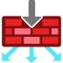

SQL Server enabled by Azure Arc – Security workflow architecture
Arc SQL Logs and Metrics flows continuously.
Inventory information is generated ~per hour.
Mandatory endpoints on Microsoft infrastructure
Arc-enabled data services endpoints *.<region>.arcdataservices.com
Private cloud environment
HTTPS/443
1
Arc-enabled server endpoints
Data
Arc-enabled server connectivity
HTTPS/443
Operating system firewall
Enterprise Proxy
TLS 1.2+
Corp firewall
Optional integration endpoints (features) on user-owned infrastructure
SQL Server
1
Microsoft Entra ID integration
2
Azure Key Vault
SQL Server service
Arc SQL extension
Azure Monitor Agent (AMA) extension
HTTPS/443
Windows Least Privilege
Certificate for Microsoft Entra ID configuration (Optional)
Data
SQL Best Practices Assessment
SQL assets
2
Log Analytics workspace
Azure Arc Connected Machine Agent
Best Practices Assessment results (Optional)
HTTPS/443
Microsoft Defender for Cloud
2
Microsoft Defender for Cloud posture results (Optional)
Log Analytics workspace
HTTPS/443
3
Additional SQL Server enabled by Azure Arc integrations (Optional)
Additional features integration

Slide 73

SQL Server enabled by Azure Arc – SQL Best Practices Assessment (BPA) architecture
Private cloud environment
Data
Operating system firewall
SQL Server
Enterprise Proxy
TLS 1.2+
Corp firewall
SQL Best Practices Assessment
Transmits report to Log Analytics workspace
3
BPA report user interface
Runs SQL Assessment and generates report
Sends report to AMA
1
2
SQL Server service
Arc SQL extension
Azure Monitor Agent (AMA) extension
Data
Windows Least Privilege
Retrieve and display BPA results
4
Log Analytics workspace
SQL assets
Data
Azure Arc Connected Machine Agent
HTTPS/443

Slide 74


SQL Server enabled by Azure Arc – Failover Cluster Instance (FCI) architecture
Arc-enabled SQL Server A
FCI-1 assets
Arc-enabled SQL Server B
FCI-2 assets
Arc-enabled SQL Server C
FCI 1 (passive)
FCI 1 (active)
network_name\instance1
FCI 2 (active)
network_name\instance2
FCI 2 (passive)
FCI 2 (passive)
FCI 1 (passive)
Arc-enabled server A
Arc-enabled server B
Arc-enabled server C
Enterprise Firewall and Proxy (Outbound only via port 443)
User-owned environment (On-premises and Multicloud)
Windows Server Failover Cluster (WSFC)
network_name\instance1
network_name\instance2
SQL Server A
SQL Server B
SQL Server C
Arc SQL extension
Arc SQL extension
Arc SQL extension
Azure Arc Connected Machine Agent
Azure Arc Connected Machine Agent
Azure Arc Connected Machine Agent
SQL Server service (Instance1, active)
SQL Server service (Instance2, passive)
SQL Server service (Instance1, passive)
SQL Server service (Instance2, active)
SQL Server service (Instance1, passive)
SQL Server service (Instance2, passive)
active
active
Cluster shared storage
Instance1 shared storage
Instance2 shared storage

Slide 75
SQL Server enabled by Azure Arc – Availability Groups (AG) architecture
SQL AG1 (primary replica)
AG1 databases
Manual failover
SQL AG1 (secondary replica)
AG1 databases
Manual failover
SQL AG1 (secondary replica)
AG1 databases
Manual failover
Arc-enabled SQL Server A
Arc-enabled SQL Server B
Arc-enabled SQL Server C
Health status
Health status
Health status
SQL AG2 (secondary replica)
AG2 databases
Health status
SQL AG2 (primary replica)
AG2 databases
Health status
SQL AG2 (secondary replica)
AG2 databases
Health status
Manual failover
Manual failover
Manual failover
Arc-enabled server A
Arc-enabled server B
Arc-enabled server C
Enterprise Firewall and Proxy (Outbound only via port 443)
User-owned environment (On-premises and Multicloud)
Windows Server Failover Cluster (WSFC)
AG1 listener1 / AG2 listener2
SQL Server A
SQL Server B
SQL Server C
Arc SQL extension
Arc SQL extension
Arc SQL extension
Azure Arc Connected Machine Agent
Azure Arc Connected Machine Agent
Azure Arc Connected Machine Agent
SQL AG1 (primary replica)
SQL AG2 (secondary replica)
SQL AG1 (secondary replica)
SQL AG2 (primary replica)
SQL AG1 (secondary replica)
SQL AG2 (secondary replica)
local storage
local storage
local storage

Slide 76




Azure Monitor pipeline – Solution architecture (Public Preview)
Edge / Multicloud
Analytics experiences built on top of telemetry collected
Edge clients (data sources)
Analytics experiences
OS-based agents
Workbooks
Cloud pipeline
Azure Monitor pipeline
Data stores
Applications
Grafana
Azure Monitor workspace
Send telemetry to cloud
Data Collection Rule (DCR)
Send data to data stores
Arc-enabled Kubernetes
Insights
Edge pipeline
Telemetry transformation
Log Analytics workspace
Edge assets
Send telemetry to edge pipeline
Send telemetry to cloud
Alerts
REST API direct ingestion
Event Hub

Slide 77
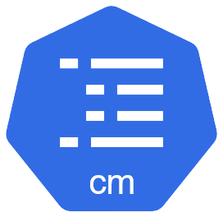
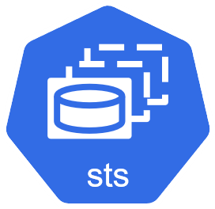
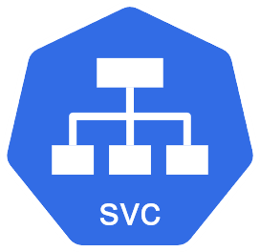
Azure Monitor pipeline – Deployment workflow architecture (Public Preview)
Azure Resource Manager (ARM)
Edge-located Arc-enabled Kubernetes cluster
Microsoft.Insights
resource provider
Microsoft.Monitor
resource provider
Azure Monitor Custom Resource Definition (CRD)
Create a ConfigMap to internally decipher OpenTelemetry collector configuration
ConfigMap
Syncs configurations
Kubernetes resource bridge
4c
Read and Write configurations
3
Azure Monitor pipeline controller
2
Collector configuration
Create a StatefulSet with Azure Monitor pipeline instance
Update detection
StatefulSet
4a
Custom Location
Azure Monitor pipeline Arc cluster extension
Port forwarding
1
1
4b
Service
Operations administrator
Create a Service to open ports for receiving telemetry
Install the Azure Monitor pipeline Arc cluster extension on the Arc-enabled Kubernetes cluster via Custom Location target
Reconcile loop based on periodic checks and event notifications to ensure valid configuration is applied

Slide 78


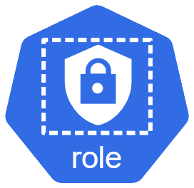
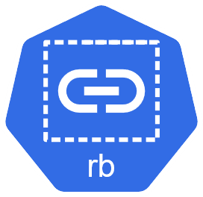
Azure Monitor pipeline – Data workflow architecture (Public Preview)
Edge/Multicloud clients
(data sources)
Edge-located Arc-enabled Kubernetes cluster
StatefulSet
Receive telemetry and open port configured for forwarding
Analytics experiences
Get identity token for authenticating against Azure Monitor
3
Azure Monitor pipeline pod
Managed service identity adapter
1
Service
2a
Data stores
Receiver
Processor
Port forwarding
Log Analytics workspace
Failure to send telemetry to cloud
9
Send telemetry to Azure Monitor
Cache Engine
4
Exporter
8
Collector ServiceAccount
Write to cache
5
Send
telemetry
Continuously check for connection to Azure
6
Read from cache upon successful connection
7
Decipher collector configuration
2b
Collector Role
Persistent Volume Claim (PVC)
Collector ConfigMap
Continuously check for connection to Azure
Collector ClusterRoleBinding
6

Slide 79

Azure Monitor pipeline – Edge-to-cloud pipeline architecture (Public Preview)
Cloud pipeline
Data Collection Rule (DCR)
Edge pipeline
Data flow
6
Data stores
Telemetry transforms applied as configured in DCR
Forward transformed telemetry
4
Send telemetry data to destination
Log Analytics workspace
Stream
Transformation
Destination
Incoming schema
5
Outgoing schema
6
Workspace
Table
Cloud pipeline accepts the incoming data
Edge pipeline configuration
Edge/Multicloud clients (data sources)
Data Collection Endpoint (DCE)
Pipeline
Receiver forwards data to the exporter
Receiver
Processor
Exporter
1
IP / Port
2
2
DCE
3b
Data Type
DCR / Stream
Exporter tries to send telemetry data to the cloud pipeline
Client sends telemetry data to the edge pipeline receiver
Exporter stores data in the local cache if it can't connect to the DCE
3a
Local cache storage

Slide 80










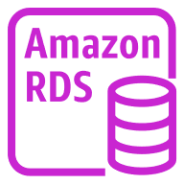
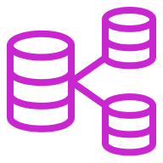




Multicloud connector enabled by Azure Arc – Solution architecture
3
Perform Multicloud-related queries against ARG
Administrator
2
Resource providers keeps resources updated
2
2
Microsoft.HybridConnectivity resource provider
Microsoft.AwsConnector resource provider
Microsoft.HybridCompute resource provider
Azure Resource Graph (ARG)
Connector:
AWS Account info
Solutions onboarded
Inventory resources (with all resource metadata):
EC2Subnets
S3Buckets
RdsDBInstances
Arc-enabled servers:
EC2 Instance as Arc server (with management services opt-in)
1
Continues sync with AWS APIs
Access via CloudFormation Stacks (OpenID Connect)
Continues sync with AWS APIs
1
EC2
S3
RDS
CloudFormation
Lambda
Additional AWS services integration with Multicloud connector enabled by Azure Arc
Future AWS services integration
AWS Services
AWS Resources
Instances
Subnets
Buckets
Access points
DB instances
DB clusters
Stacks
Stacks sets
Functions
AWS APIs

Slide 81
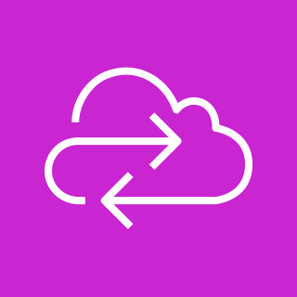



Multicloud connector enabled by Azure Arc – Workflow architecture
Onboard AWS Account:
OpenID Connect Federation, IAM roles and permissions for Arc application
Arc Multicloud connector leveraging AWS management APIs
2
AWS APIs
Account
IAM Role(s)
CloudFormation Template
Operator uses the bearer token to request a temporary access token.
A temporary access token is generated and sent back to the Operator.
Discover AWS resource type
4
3b
Azure Resource Manager (ARM)
1a
A temporary access token is sent from Operator to Arc Resource Sync
Create Connector passing AWS Account
/hybridConnectivity/ publicCloudsConnector
Microsoft.HybridConnectivity resource provider
Arc Resource Sync
(Async onSchedule)
3a
Arc Identity Operator
Configure SolutionConfig
/hybridConnectivity/ solutionconfigurations
5
1b
Creates Arc Multicloud resources
Microsoft Entra ID
Microsoft.HybridCompute resource provider
Microsoft.AwsConnector resource provider
3c
Arc Resource Sync initiate a request to the Operator.
Operator requesting and receiving bearer token back from Microsoft Entra ID.
Administrator
Azure Resource Graph (ARG)
5
6
Perform Multicloud-related queries against ARG
Arc resources

Slide 82











App Development Tools for Kubernetes – Solution overview architecture (Public Preview)
Edge deployed, Arc-enabled Kubernetes cluster
Extensions Bundle and Versioning
Azure Container Storage enabled by Arc (ACSA)
Azure Key Vault Secret Store extension
Azure Monitor Pipeline (1st party)
Deployed application supported on Arc-enabled Kubernetes
Azure Marketplace
Published application
Core services
Azure Arc gateway
Workload identity federation in Azure Arc-enabled Kubernetes
Visual Studio Code
Azure Arc VS Code Extension
Inner loop
Outer loop
Azure Arc VS Code extension enables you to set up a local or cloud dev environment, create service templates, and explore sample apps with Jumpstart
Developer
DevOps
Templates
Snippets
SDK
AKS on WSL
Jumpstart

Slide 83


App Development Tools for Kubernetes – Application deployment workflow (Public Preview)
Developer writes application code, followed by a Kubernetes deployment manifest with required Arc cluster extensions integration dependency definition
Inner loop
Outer loop
1
DevOps triggers deployment of the application from Azure Marketplace
5
Developer
DevOps
Visual Studio Code IDE
Application source code (business logic)
Kubernetes application deployment manifest (yaml)
Azure Marketplace
Cluster extensions dependency definition
Deployment definition
Published application, supported on Arc-enabled Kubernetes
Application developer publishes the application to Azure Marketplace
{
"DependsOn": {
"AppPlat" : {
"MinVersion": "1.0.0",
"MaxVersion": "1.1.8",
"Capabilities": {
"Observability": { "key1": "value1" },
"Storage": { "key1": "value1" }
}
}
}
}
4
Arc-enabled Kubernetes ARM resource
Arc Kubernetes Bridge
6
Arc Kubernetes Bridge resolves cluster extensions dependencies automatically upon API request and deploy any missing Arc extension on-demand along with the application to the Arc-enabled Kubernetes cluster
3
Windows Subsystem for Linux (WSL)
VS Code Extension
Developer performs integration testing on local environment
Developer deploy local AKS Arc cluster on WSL using VS Code extension
Edge deployed, Arc-enabled Kubernetes cluster
Arc extensions
Application
AKS Arc (deployed on WSL)
2

Slide 84


App Development Tools for Kubernetes – Extension bundle incompatible version installation (Public Preview)
3
DevOps
Compatibility checks returns with “ExtensionOperationFailed” error and does not proceed with the extension deployment
1
Attempt to install or update incompatible extension version v1.201 is made
Edge deployed, Arc-enabled Kubernetes cluster
Compatibility checks run on cluster, identifying the incompatible v1.201 extension deployment request
2
“Graytown” extension bundle
Current version: v1.199 / Next compatible version: v1.200
Azure Container Storage enabled by Arc (ACSA)
Compatible version: v1.209
Azure Key Vault Secret Store extension
Compatible version: v1.13
Azure Monitor Pipeline (1st party)
Compatible version: v1.140
Arc agent
Version: v1.200

Slide 85

App Development Tools for Kubernetes – Extension bundle compatible version installation or update (Public Preview)
3
DevOps
Compatibility checks returns with “Succeeded” message and proceed with the requested extension deployment
1
Attempt to install or update compatible extension version v1.200 is made
Edge deployed, Arc-enabled Kubernetes cluster
Compatibility checks run on cluster, identifying the compatible v1.200 extension deployment request
2
“Graytown” extension bundle
Current version: v1.199 / Next compatible version: v1.200
Azure Container Storage enabled by Arc (ACSA)
Compatible version: v1.209
Azure Key Vault Secret Store extension
Compatible version: v1.13
Azure Monitor Pipeline (1st party)
Compatible version: v1.140
Arc agent
Version: v1.200

Slide 86

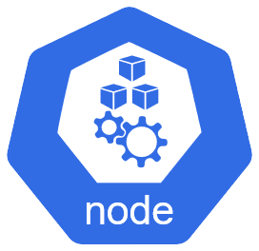




Kubernetes AI Toolchain Operator (KAITO) – Solution Architecture
Control Plane node
Provisioned GPU worker nodes
Microsoft Container Registry (MCR)
API Server
GPU worker node 1
Model workload deployment
AI model Images
Inference or Tuning workload (Deployment, StatefulSet, or Job)
Workspace Custom Resource
nodeClaim Custom Resource
GPU worker node 2
Private Container Registry
Created based on the model preset configurations
Model workload deployment
GPU worker node n
AI model Images
Karpenter APIs
Node provisioner (gpu-provisioner) controller
Workspace controller
GPU node provisioning
Supported
Azure Kubernetes Service (AKS)
Edge-located Arc-enabled Kubernetes

Slide 87


Azure Monitor dashboards with Grafana – Kubernetes Observability Solution Architecture
Operations administrator
Azure template dashboards
Imported Grafana community dashboards
User custom dashboards
Azure Kubernetes Service (AKS)
Azure Monitor dashboards with Grafana
Data Queries
Role-Based Access Control for authentication and authorization
Data sources
AKS support
Azure Monitor Managed Prometheus
Azure Monitor
Microsoft Entra ID
Metrics
Log Analytics
App Insights
Azure Resource Graph
Arc-enabled Kubernetes support
Edge-located Arc-enabled Kubernetes

